Slide 1
Electronic reporting in Microsoft dynamics 365 finance and operation

Slide 2
What is Electronic Reporting?
Generic Electronic Reporting (GER) or Electronic Reporting (ER) is a new configurable tool in Dynamics 365. We can use it to configure formats for both incoming and outgoing electronic documents. No coding or queries are required, meaning functional consultants or business users who have good knowledge of the Dynamics 365 data structure can easily configure ER.
You can use this tool for internal reporting, data loads, as well as external reporting (e.g. legal requirements of various countries/regions)
The implementation is vast: you can adopt new regulatory requirements and generate business documents accordingly
You can electronically exchange these documents with government bodies, banks, and business partners (e.g.. vendors and customers)
You can manage multiple formats during their lifecycle. In ER, as the focus is to configure formats instead of coding, so the process of creating and adjusting custom formats for electronic documents is quick and easy
ER currently supports the TEXT, XML, Microsoft Word /Excel documents, and OPENXML worksheet formats
you can distribute formats to partners and customers through Microsoft Dynamics Lifecycle Services (LCS).

Slide 3
What is reporting configuration
At the basis of each ERC is a configuration provider. The configuration provider is the owner of the ERC and is the party authorized to make changes to the configuration. The configuration provider Microsoft.com is present by default.
A configuration can be directly imported from a file or it can be imported from a repository. A repository is a storage location that can be used as a source for Electronic reporting configurations.
​A configuration provider can have 3 types of repositories
1.Operation Resources 2.LCS(life cycle services) 3.RCS (Regulatory configuration services)

Slide 4
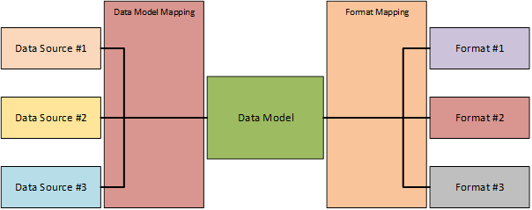
Electronic reporting Configuration structure

Slide 5
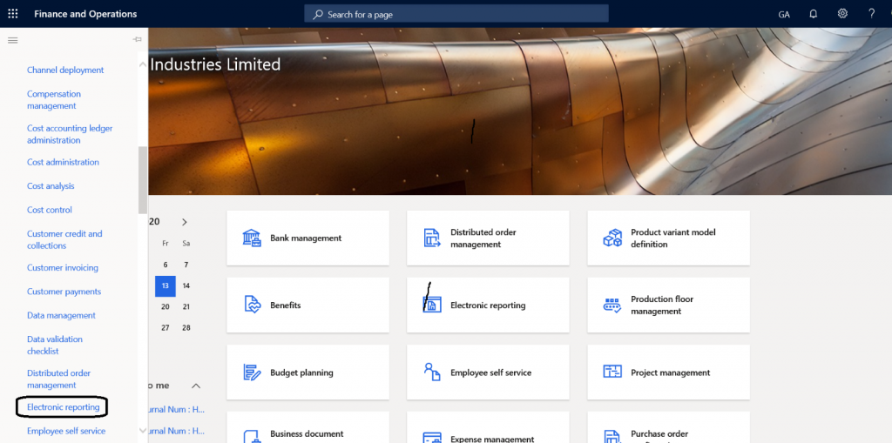
How to set Report configuration provider
Go to workspace >Electronic reporting

Slide 6
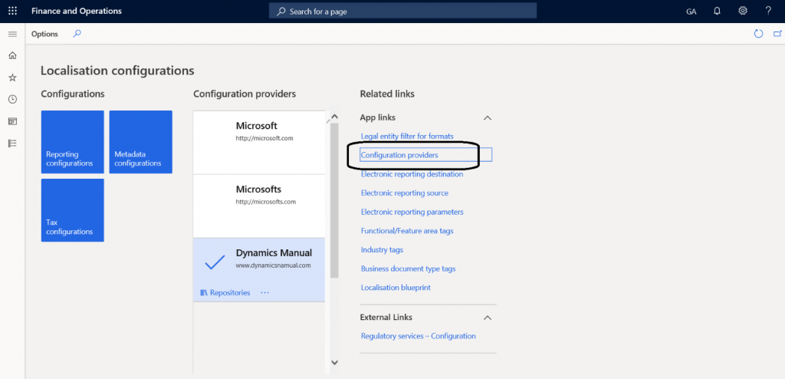
Go to Configuration button related to the link.

Slide 7
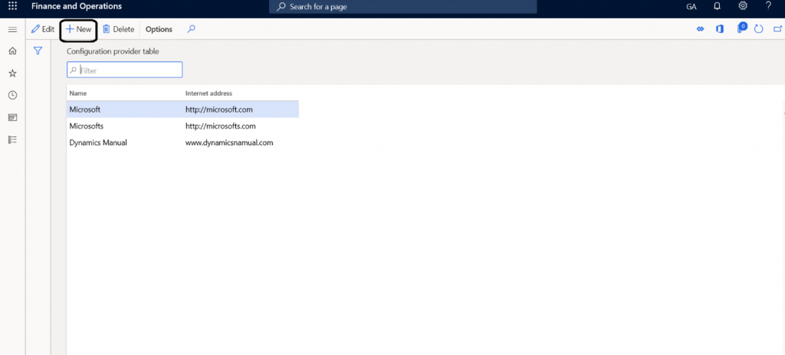
Click on the new button to create configuration provider
Give the name and respective Internet address to do the configuration.

Slide 8
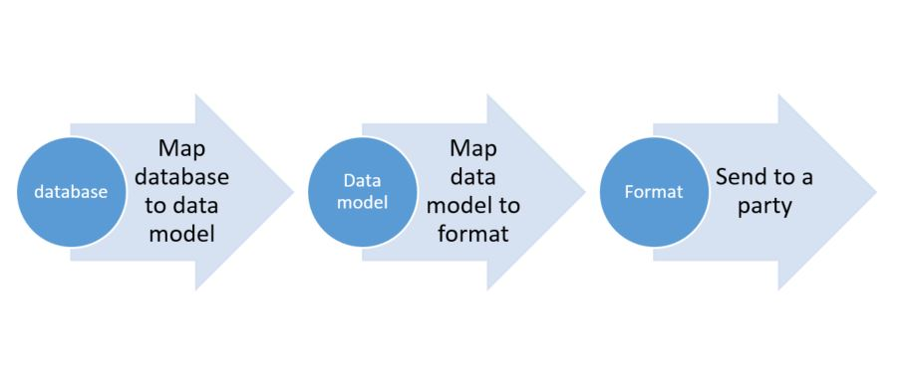
Components of Electronic reporting
There are there types of components of electronic reporting
Data Model: Provides the structure through which data is available to the designer.
Data mapping: Data mapping is for the mapping of data sources in Dynamics 365
Format: Format is the output of the report

Slide 9
what is data model?
A data model is the key element in an Electronic Reporting Configuration, providing the structure for the data sources to be bound to via a model mapping and providing the source for format configurations to have the output elements bound to.
it is a container of a record. It should have enough details to fulfill the reporting need. Data can be related to any business domain area. The data model includes data items or fields. Each data item can be recognized as a string, integer, real, date, enumeration, Boolean, and so on. If needed a data model can also include other records or a record list.
Before creating a custom data model, it is recommended to check if a similar data model already is provided by Microsoft in LCS. If a configuration is provided by Microsoft and this is not fitting for your needs, you can create a custom configuration based on the Microsoft Data model.
This Data Model is then called a derived configuration. The main advantage is that you do not have to start from scratch and if the data source is updated, you can use the updated model from Microsoft, you only have to worry about the fields you have changed.

Slide 10
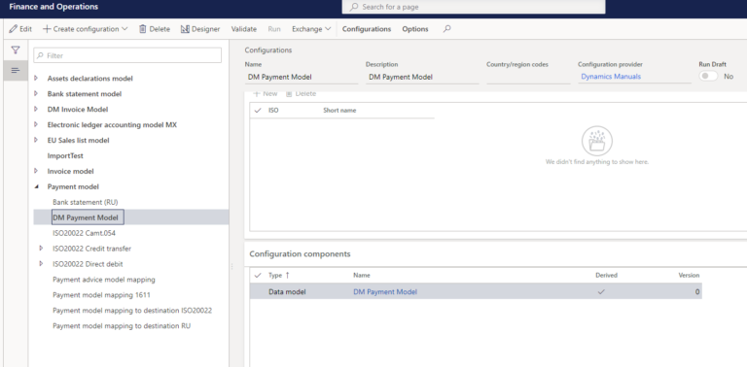
Derived Data model
To create a Derived data model, select the data model you want to derive from and click on create configuration. Select Derive from Name: <data model> and click Create. If you see the configuration provider Microsoft here, you first have to create your own configuration provider as described in this post. Enter a name and description and click on create.

Slide 11
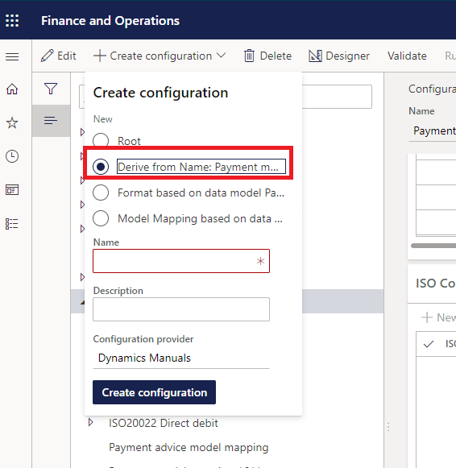
Derive data model

Slide 12
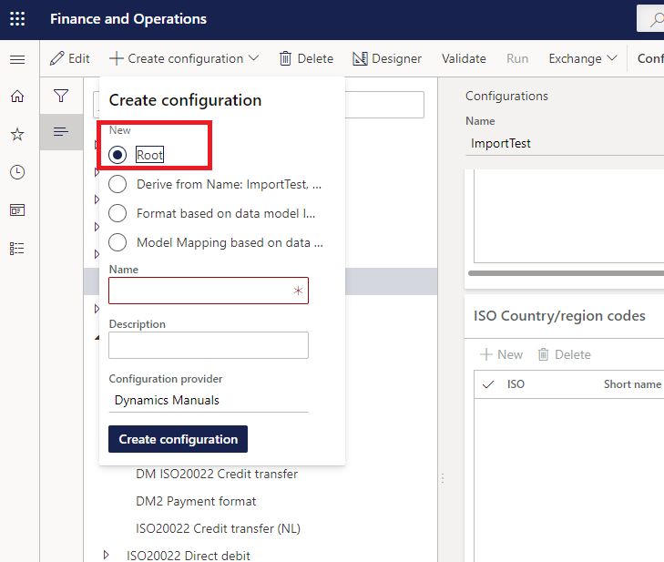
Alternatively, if you do not see any data source suitable from the Microsoft LCS or other sources, you can create a brand-new data model. To do this click on create configuration (it does not matter if you have selected any existing configuration) and select Root and give in a name and description. A new root is a data model by default, this can not be changed.
After that we can add our field in the data model according the requirement which I will explain in further slide.

Slide 13
Data model Mapping
the model mapping is the binding of the data source in D365FO, which can be a table, a data entity, a map or a view to the Data Model. Since update 1611 it is possible to separate the model mapping in its own ERC, but it is often combined in the data model. The mapping can be to a model (= export) or a destination (= import).
A model mapping can have two directions, To Destination which is used for importing data and To Model which is used for exporting data. The same goes for a format mapping, when exporting data, the mapping is performed directly in the designer and when importing data, the mapping is performed via the model mapping in the format mapping. The image below illustrates this.

Slide 14
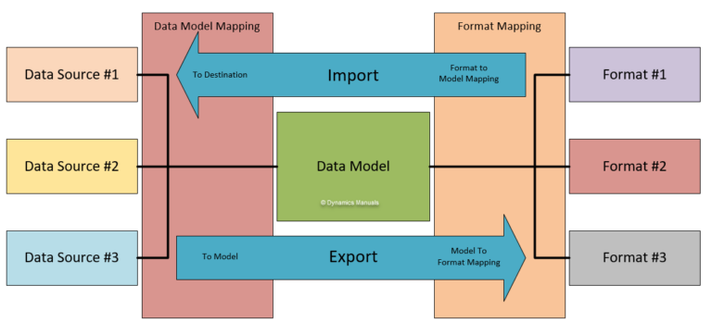

Slide 15
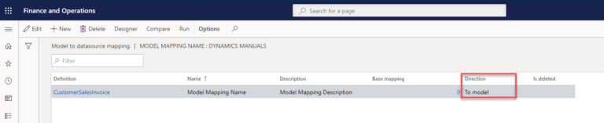
To create a model mapping select the data model you want to create the mapping for and click Create configuration. Enter a name and select the data model definition you want to use in the mapping and click create configuration.
We have now done the first step in creating a model mapping and that is creating the configuration. The second step is to create the actual mapping and by this telling Electronic Reporting the direction we are creating the mapping for. Click on Designer and you will see that Electronic Reporting defaulted in a To Model direction (export) for our model mapping.

Slide 16
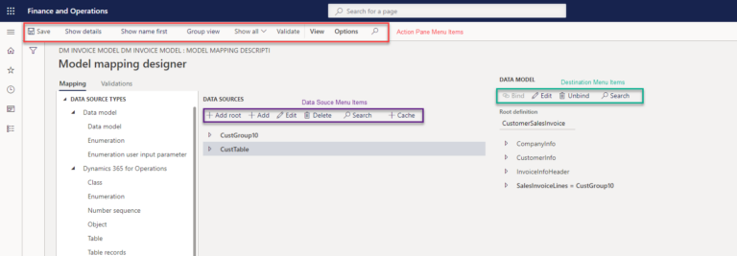
Model Mapping Designer Menu Overview
In further slide I will explain how to mapped data model field with the data source.Here you might get idea how it works.

Slide 17
Format mapping
The format mapping is the binding of the format destination or source (the file) to the data model. Setting up a new Electronic Reporting configuration requires you to follow the order Data model, to Model Mapping, to Format Mapping.
The format mapping is the configuration component which determines the type of input or output file. Because of this characteristic the configuration components and use differ slightly per file type you are configuring, configuring a format for import requires a different approach in setup than a format for export. Another feature is that you can write back information into Dynamics 365 for Finance and Operations based upon the exported data, this can be very useful but complex in set up as well.

Slide 18
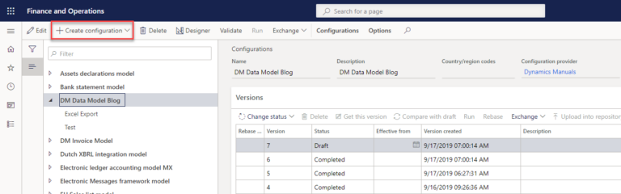
Create export Format mapping
To create a new export format mapping select a data model you want to create a format mapping in and click on <create configuration>.

Slide 19
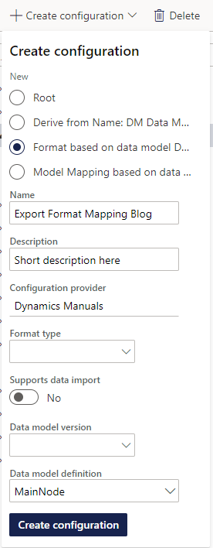
Then select the radio button <Format based on data model XYZ> and enter a name.
The description is optional but recommended to fill in and for an export format you are required to select the Data model definition you are basing the export format on.
Leave the format type empty, this is intended for import formats and selecting a format type will limit the choices you have later in the format editor and leave Supports Import on No
The data model version is optional to fill in, but I recommend keeping it empty as Electronic Reporting will fill in the latest version by default.

Slide 20
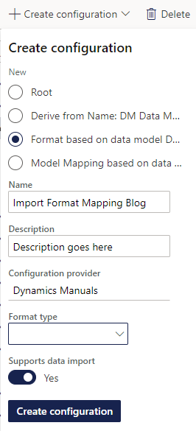
Creating an Import Format Mapping
The creation of an import format mapping is much like an Export Format Mapping click on <create configuration>.
Again, select the radio button <Format based on data model XYZ>, and enter a name and an optional description. Set the radio button for supports data import to yes and determine a file format type you will be importing.
Although the file format type is not mandatory, it is recommended to fill in as imports are not run from the format mapping but from the model mapping. Because there can be multiple import format’s pointing at the same model mapping, this format type field tells Electronic Reporting which format mapping to use for which file type. Besides this, the file type filters the available options in the mapping designer as well, making configuration a little bit easier because of the cleaner drop downs. Click on create configuration to create the import mapping.

Slide 21
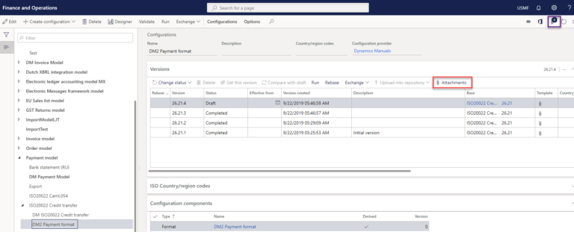
Attachments
Electronic reporting supports different file types for importing data and exporting data. The format mapping is the configuration which determines the file type. When exporting files, a file is created, and its contents are mapped by this configuration. When exporting data to a text-based file (JSON, XML, Other Text), Electronic Reporting can facilitate creating the file and performing the mapping of the data.
However, when exporting data to a file which is not text-based (Excel, Word, PDF), Electronic Reporting can’t create the file and requires a template file to which the data is mapped. This template file is added as an attachment to the format mapping configuration.
How can we mapped format with the data model .I will explore it with the requirement.

Slide 22
Requirement
Now I will explain what I discussed in the previous slides.
Suppose we have a requirement to add a Cust Group Name in sales Invoice Report.
For fulfillment of this requirement we need to find the Data source and model related to this field.
So firstly we will import model and add the field in the model then this field will mapped with data source and after that we will proceed the formatting part.
.So Now we will import model , mapping and format related to this requirement from the LCS .
Version of these should be same .

Slide 23
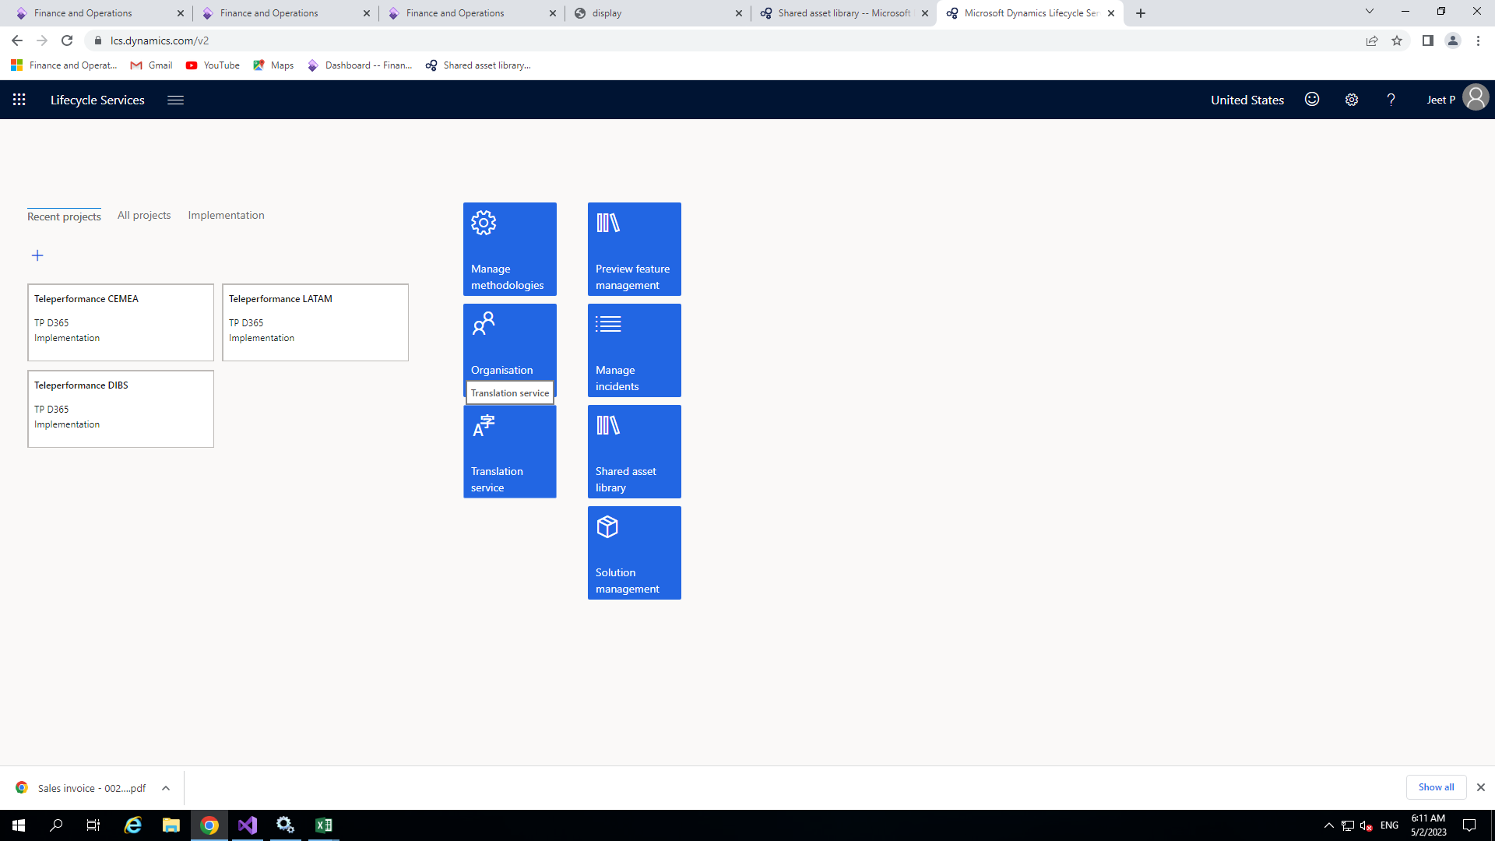
How to do it?
Import Microsoft Model, Mapping and Format for ER
For importing Microsoft model, format and model mapping first of all go to LCS by simply type lcs.dynamics.com in the address bar of the browser.

Slide 24
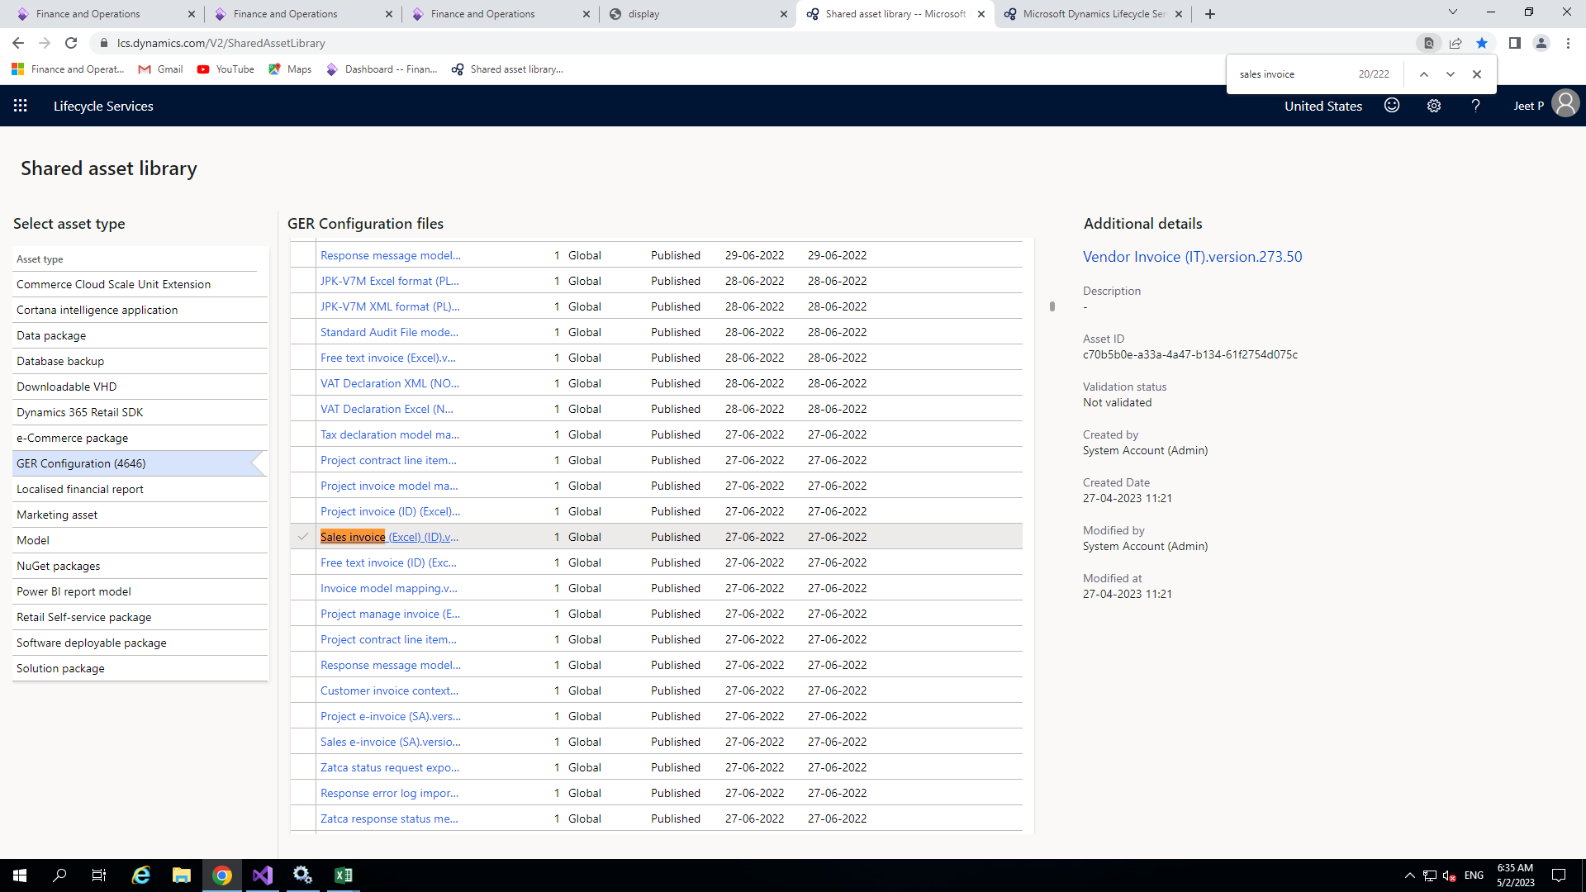
After that go to shared asset library -> GER Configuration and search for Invoice model , Invoice model mapping and sales invoice(Excel) template of appropriate version. The version of all these should be same .

Slide 25
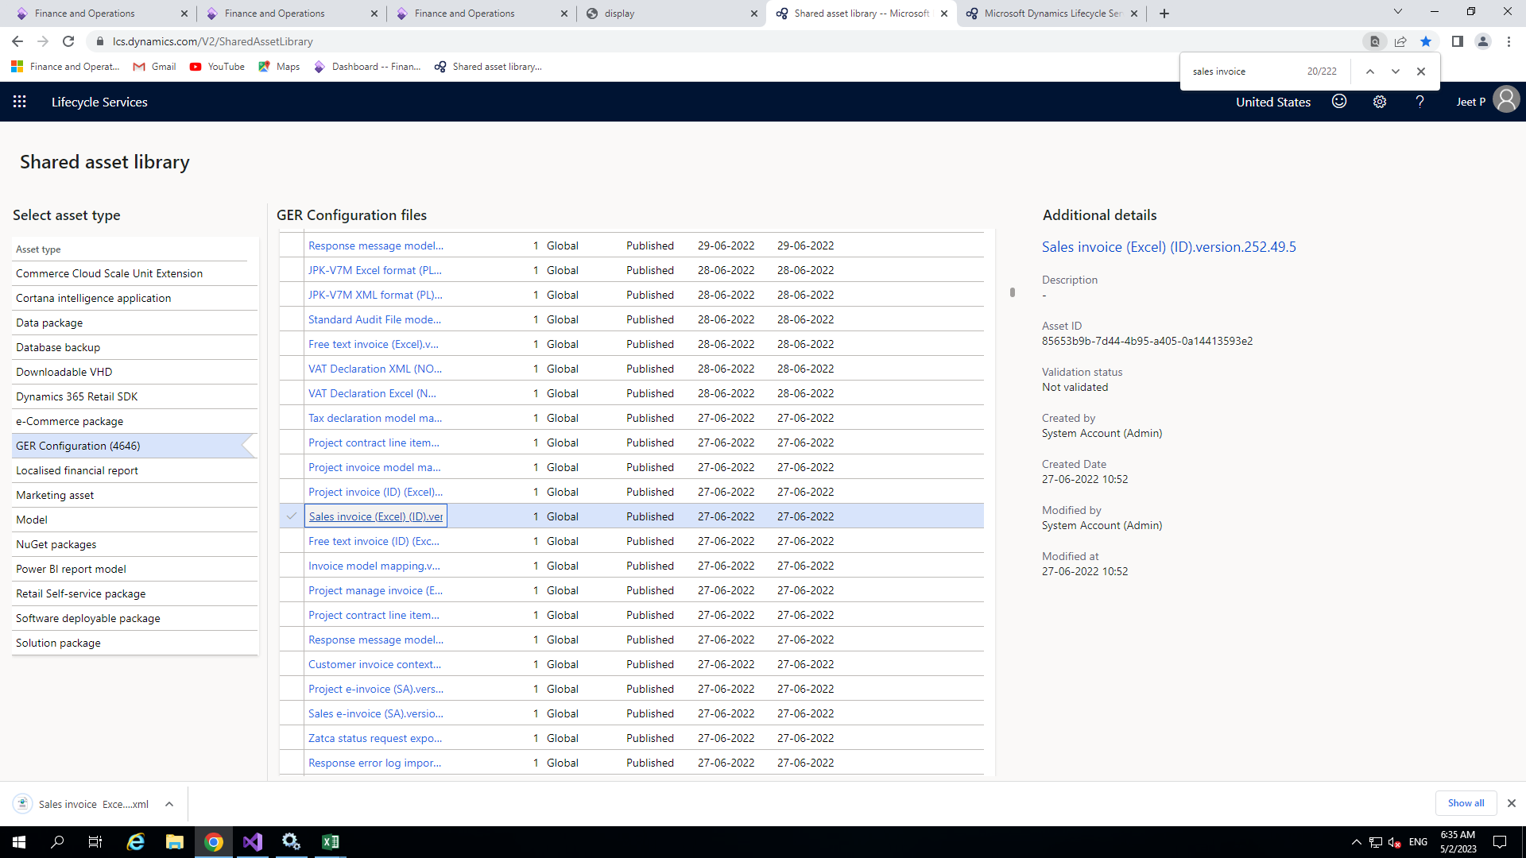
Just simply click on these then the appropriate xml file will download.

Slide 26
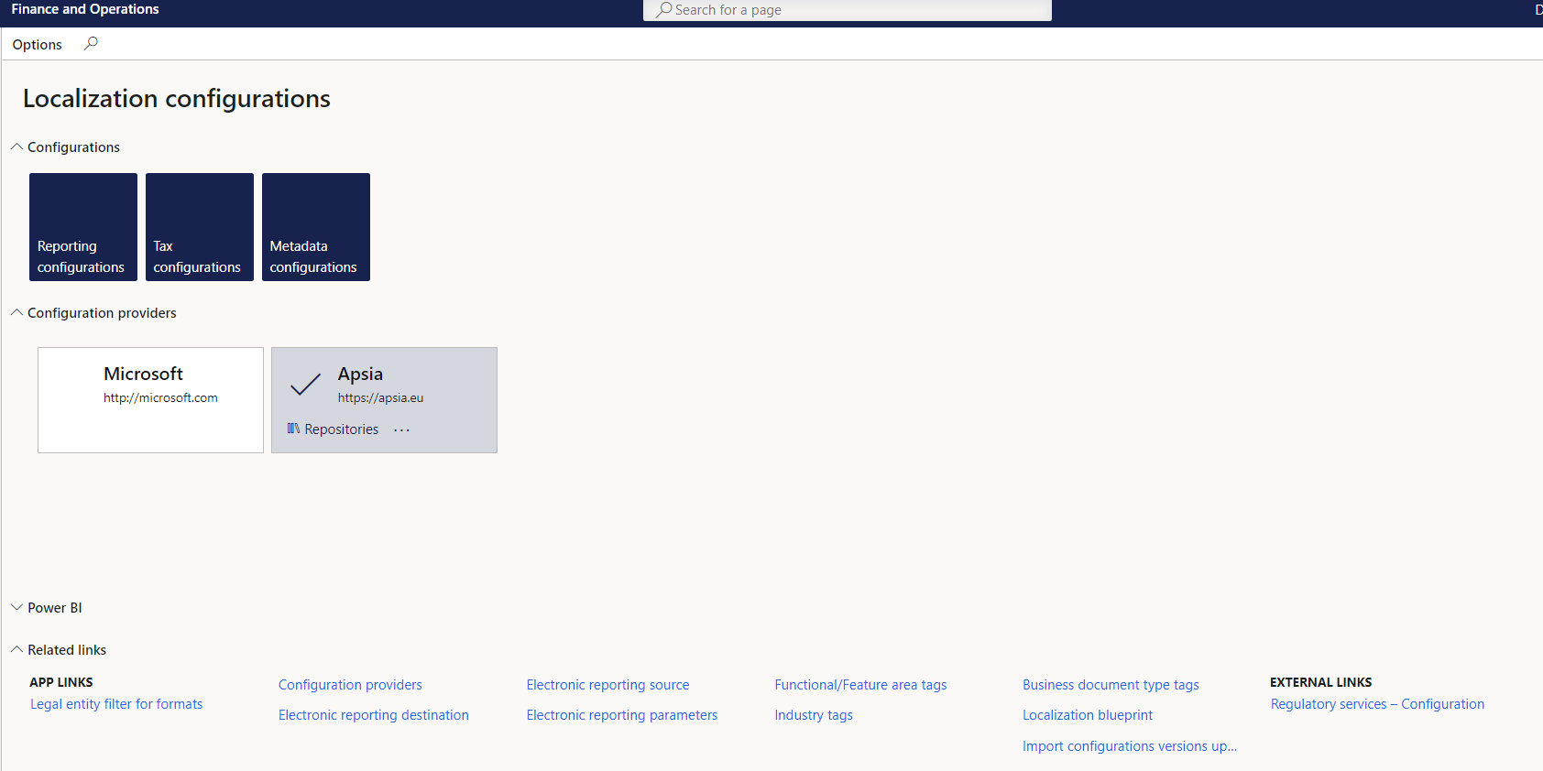
Creating new configuration
Now open workspace in D365 F&O front end then workspace -> Electronic Reporting

Slide 27
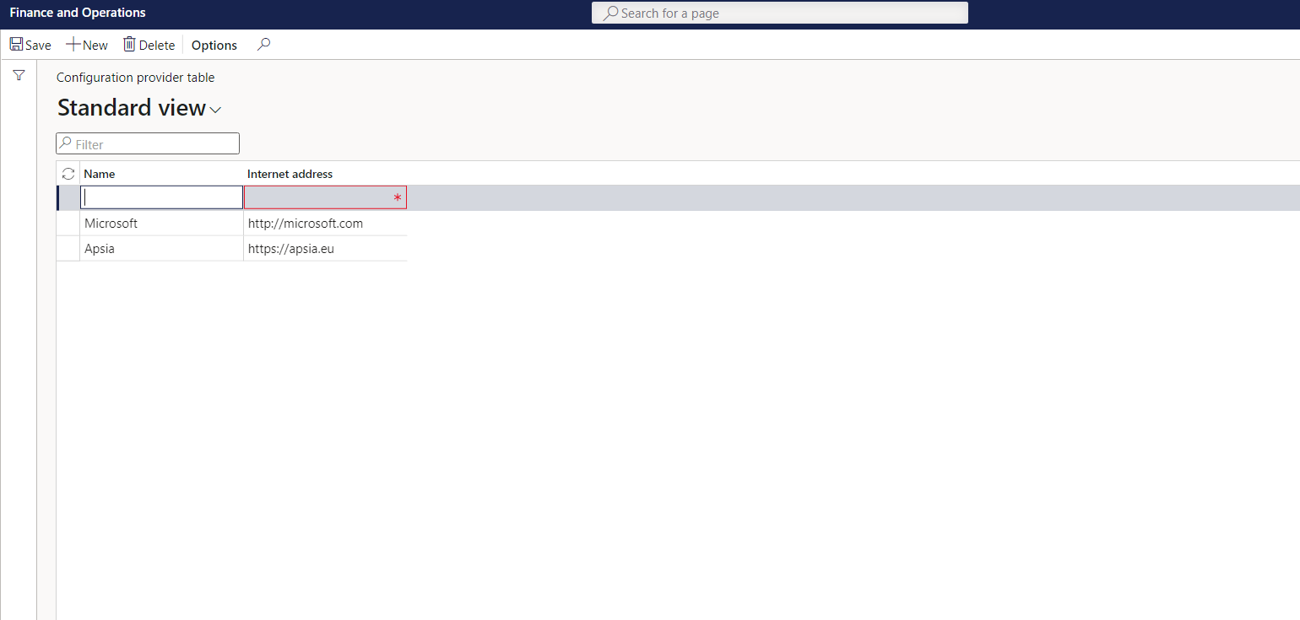
Now for creating new configuration providers
Go to Workspace > Electronic reporting. And then click on Configuration providers
Add the name of new provider and the HTTP address.

Slide 28
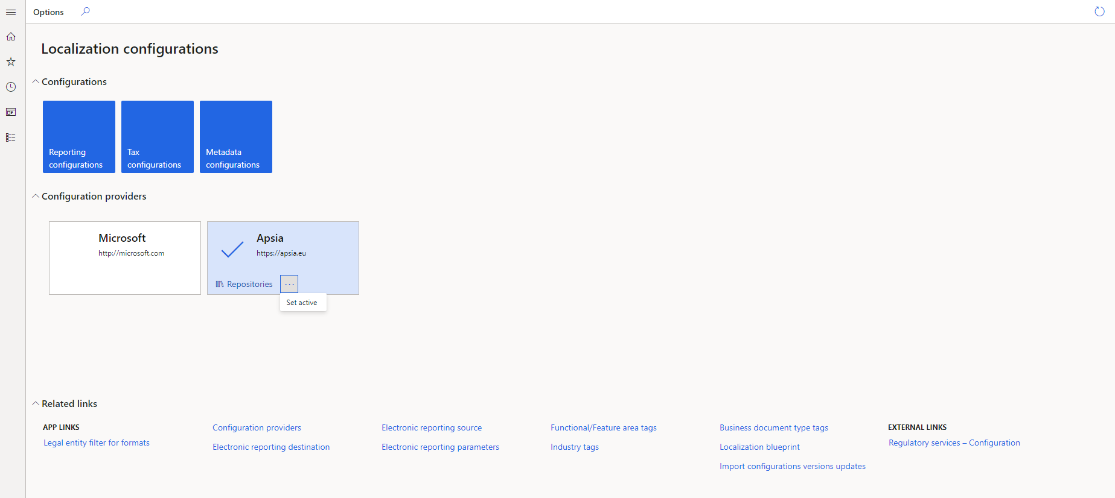
Now save it and set your configuration provider set as active .

Slide 29
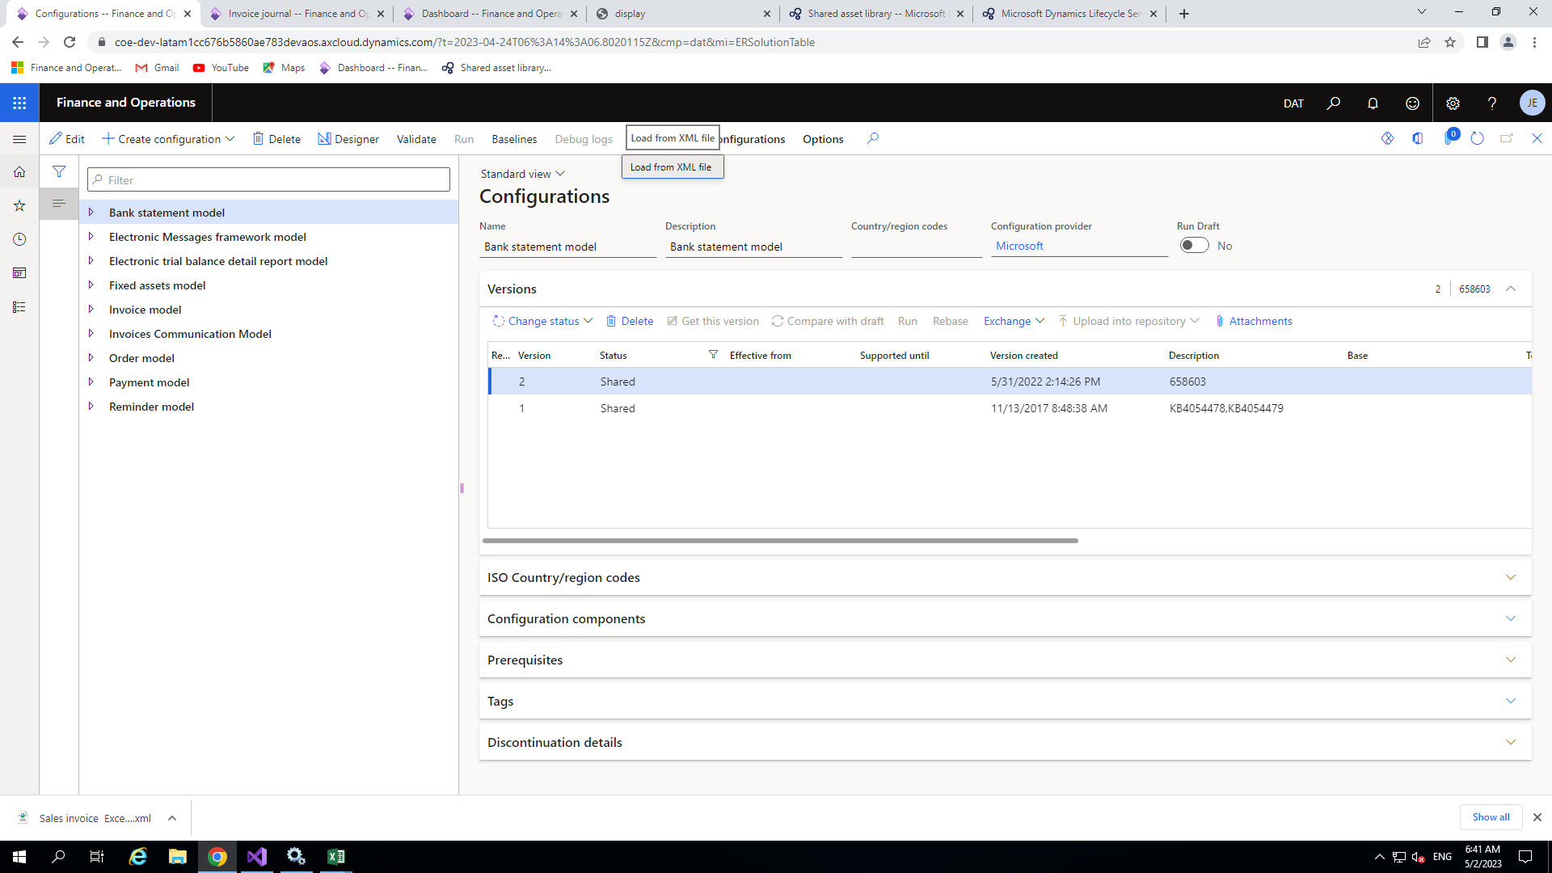
Now click on configuration provider other than Microsoft and click on reporting configuration then the following window will open.

Slide 30
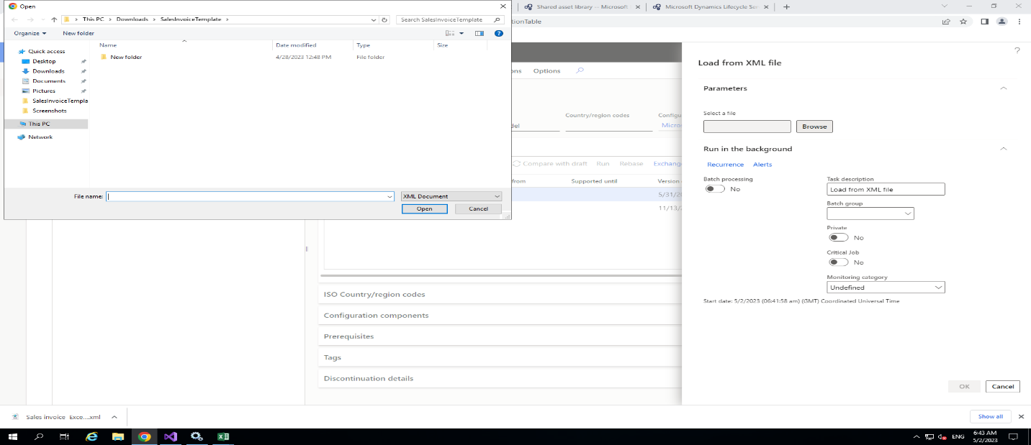
Now click on exchange > load from XML and choose the downloaded xml file which you downloaded from LCS go to your downloaded location and open it one by one.

Slide 31
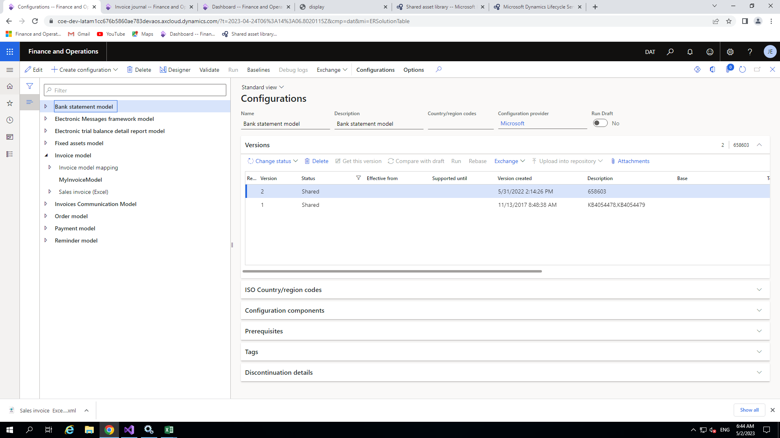
Model configuration
After importing all the files, Your model, mapping and format will appear in the window but it is recognized as Microsoft configuration .For the customization you need to create your own model for the configuration in your configuration provider , so click on the model then click on the create configuration button to add the extension of the model.

Slide 32
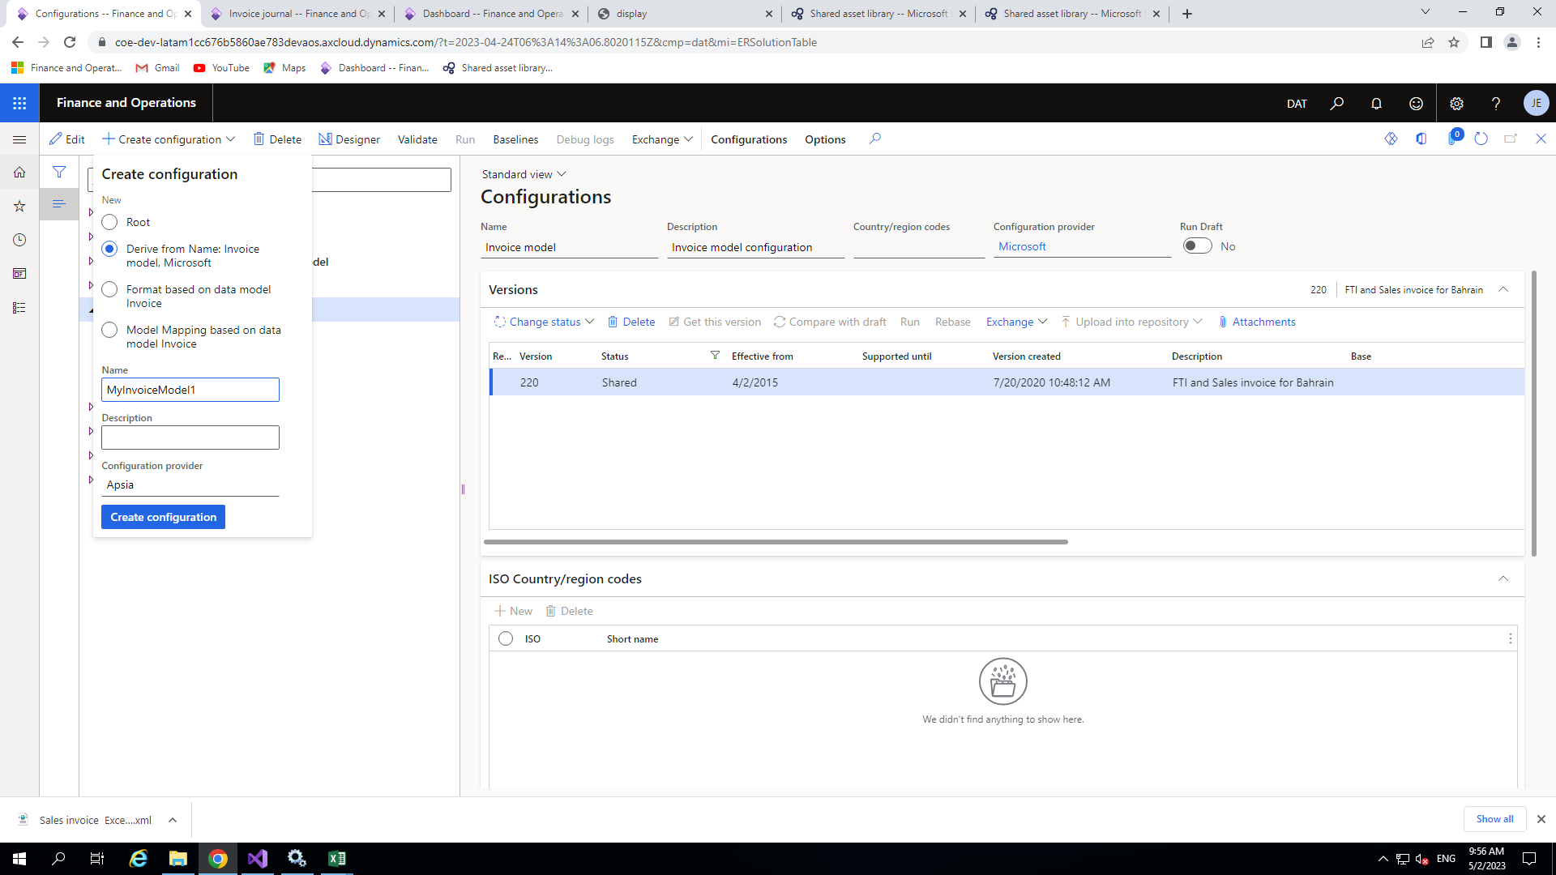
So now we will create one extension for that, click on main model and then click on create configuration .Give the appropriate name(like MyInvoiceModel) and check the radio button<Derive from name Invoice model Microsoft >
Simply you are extending existing one for the configuration.

Slide 33
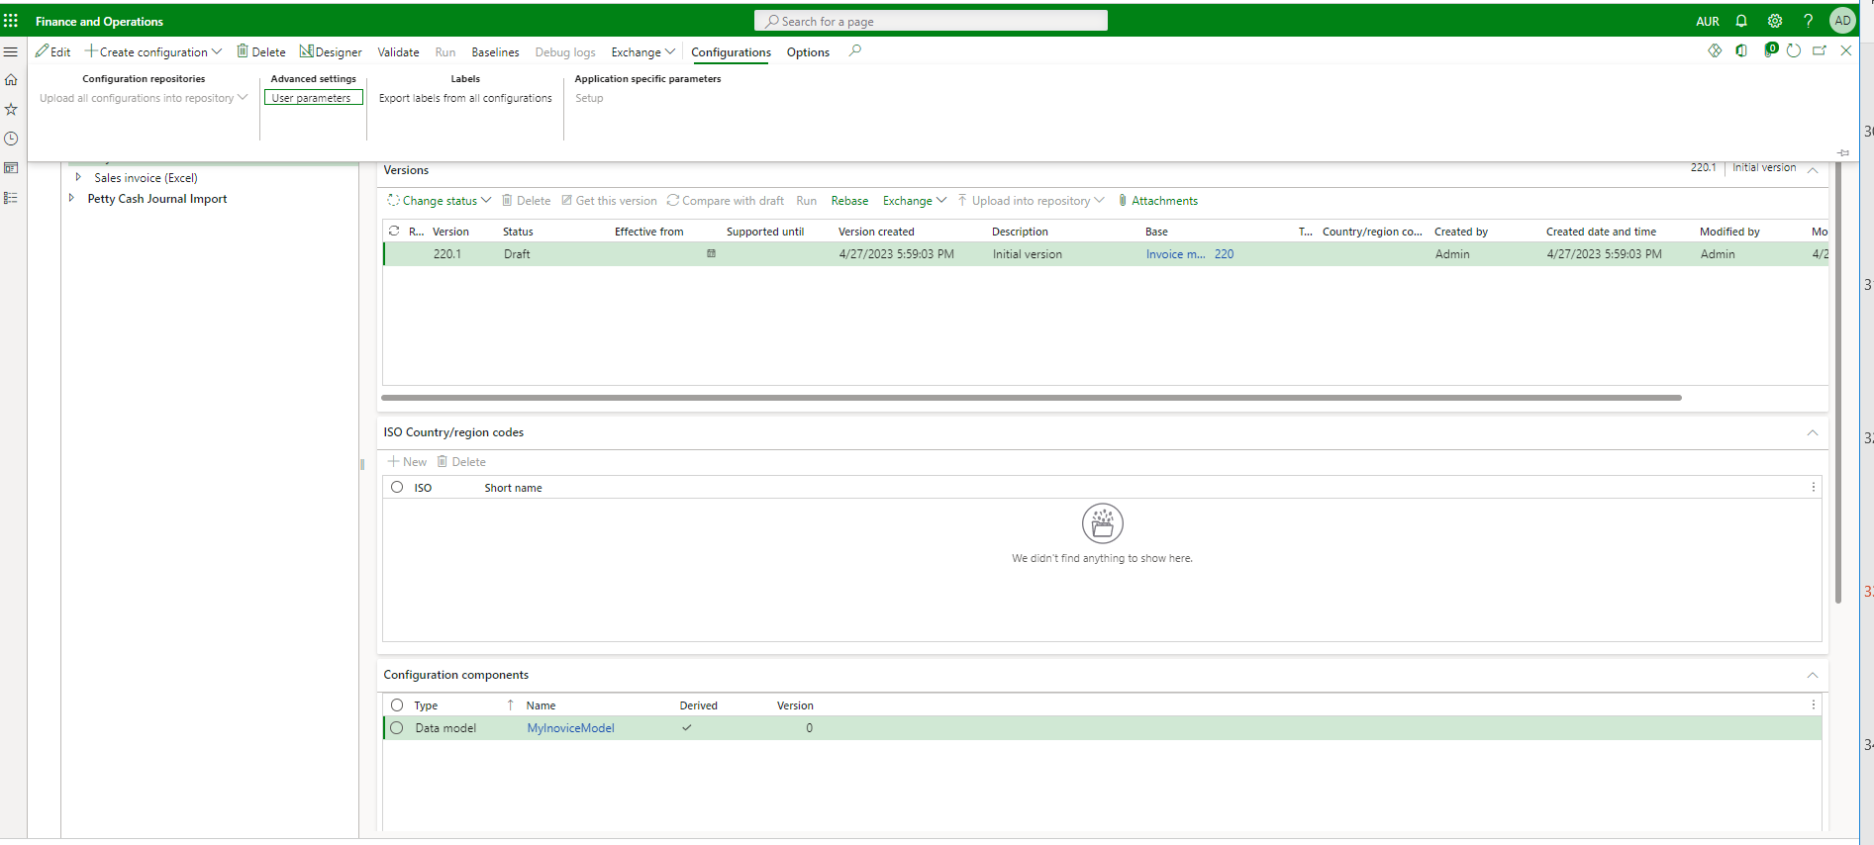
After adding new data model configuration click on that model and then configuration>User parameter

Slide 34
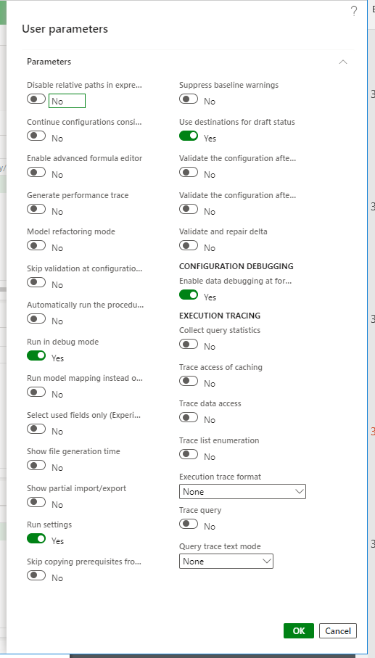
Then turn on the parameter which is showing in the picture then you can debug your output in order to get the right output.

Slide 35
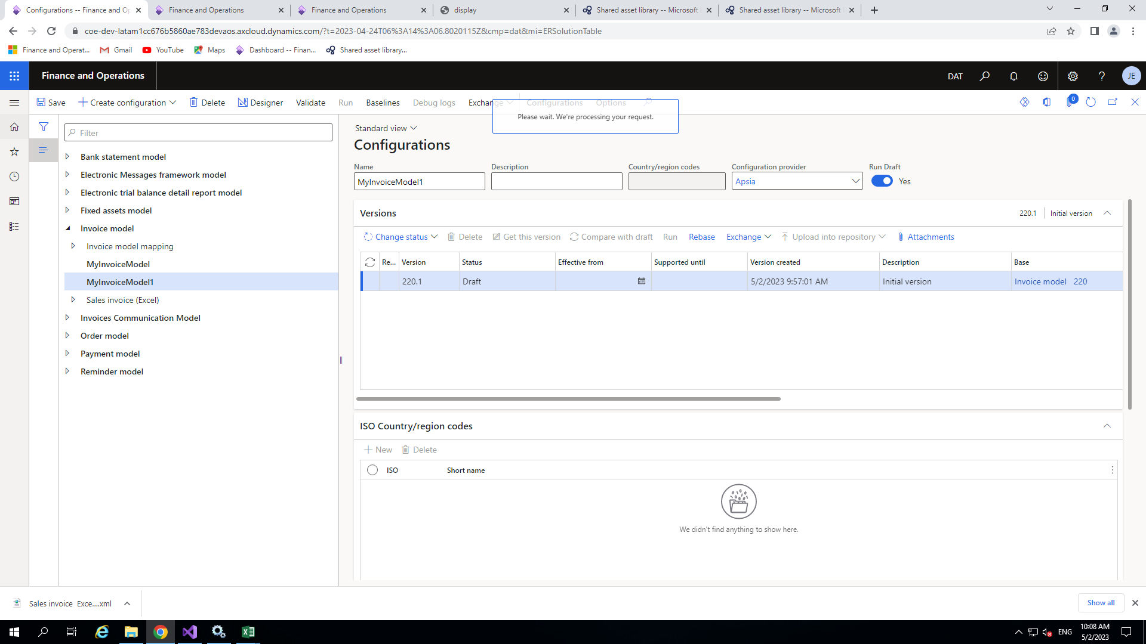
Adding new field in the data model
After setting the parameter select the model and click on designer.

Slide 36
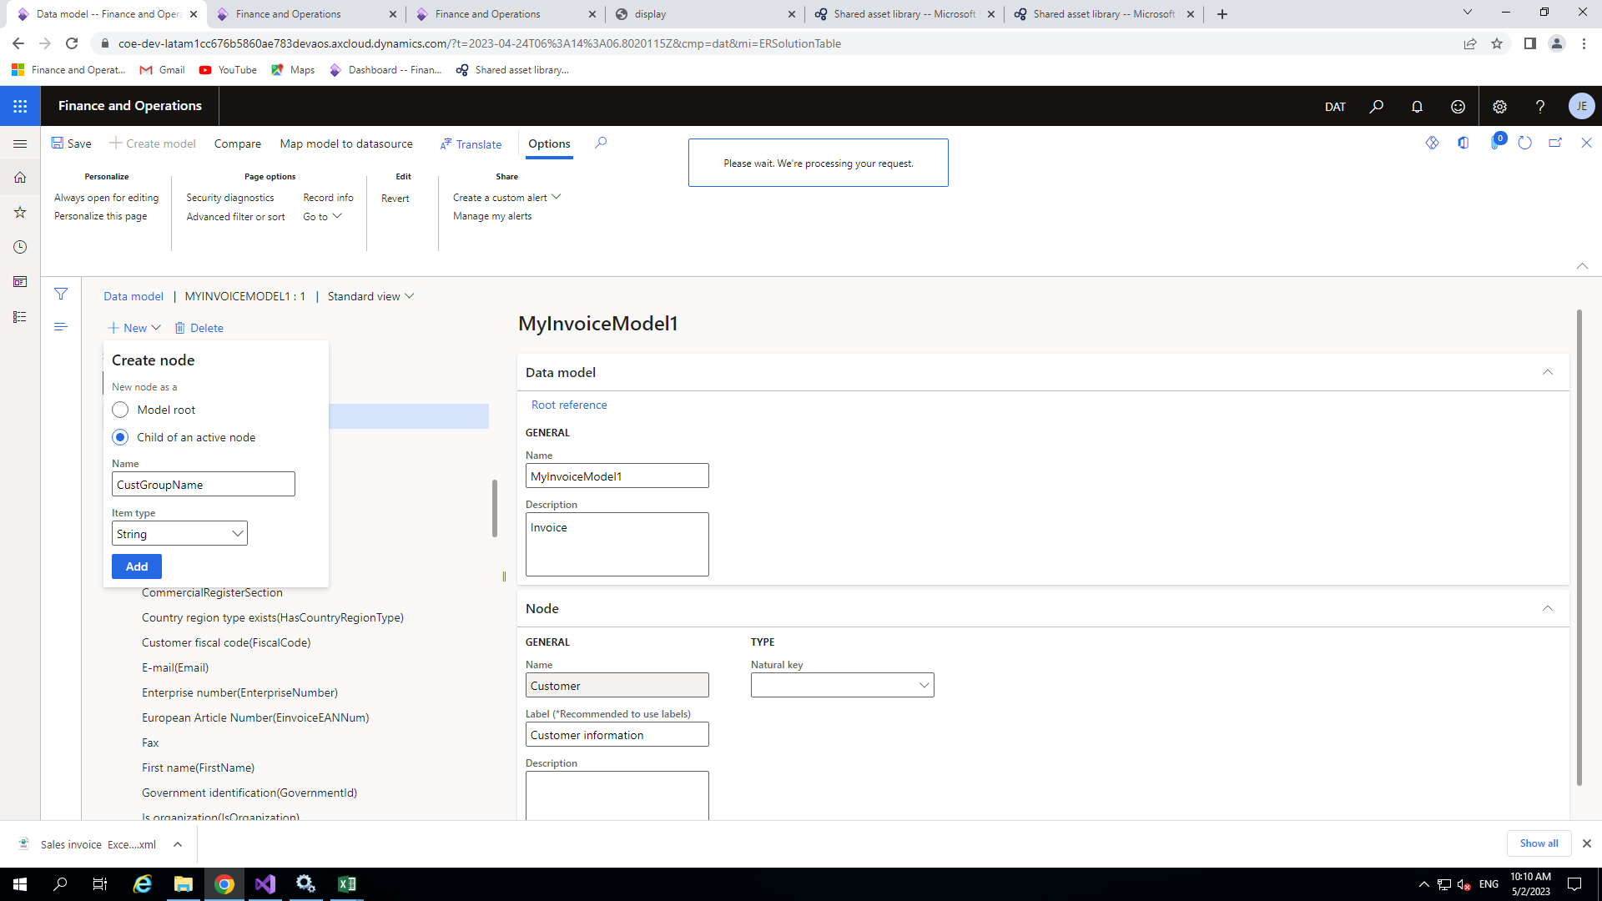
Now our requirement is to add a field in the data model under appropriate node.As per my requirement I am going to add our CustGroupName field which will be string type under Customer information node.
For adding select customer information node and click on new button check the radio button <Child of an active node> the give proper name(CustGroupName) choose item type as string after that click on add. It will be add under customer information node

Slide 37
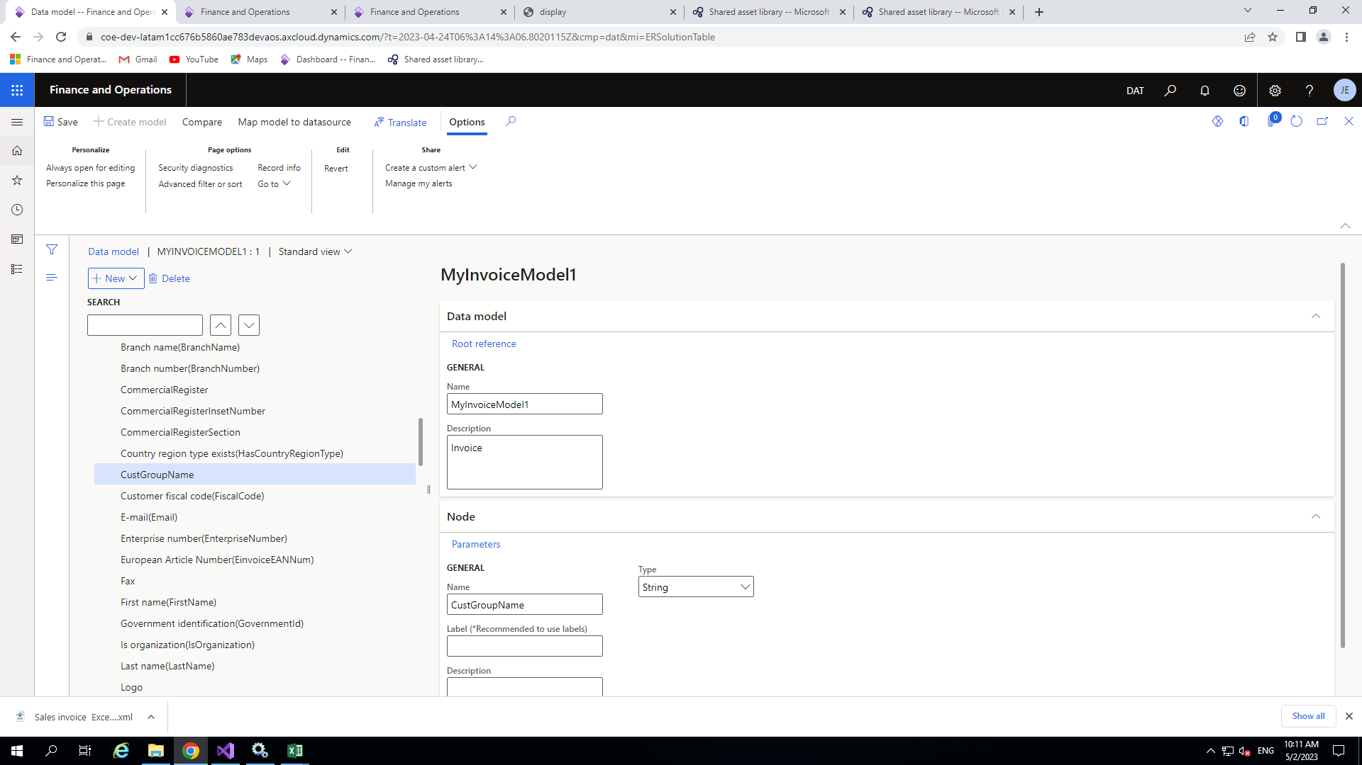
After adding the node our node looks like this

Slide 38
Model mapping configuration
Like model configuration we will create the model mapping configuration for the customization in our configuration providers.
So choose your model mapping in my case I choose Invoice model mapping and clicked on create configuration.
Give the proper name like MyInvoiceModelMapping chooser your configuration provider under target model then click on Create configuration.

Slide 39
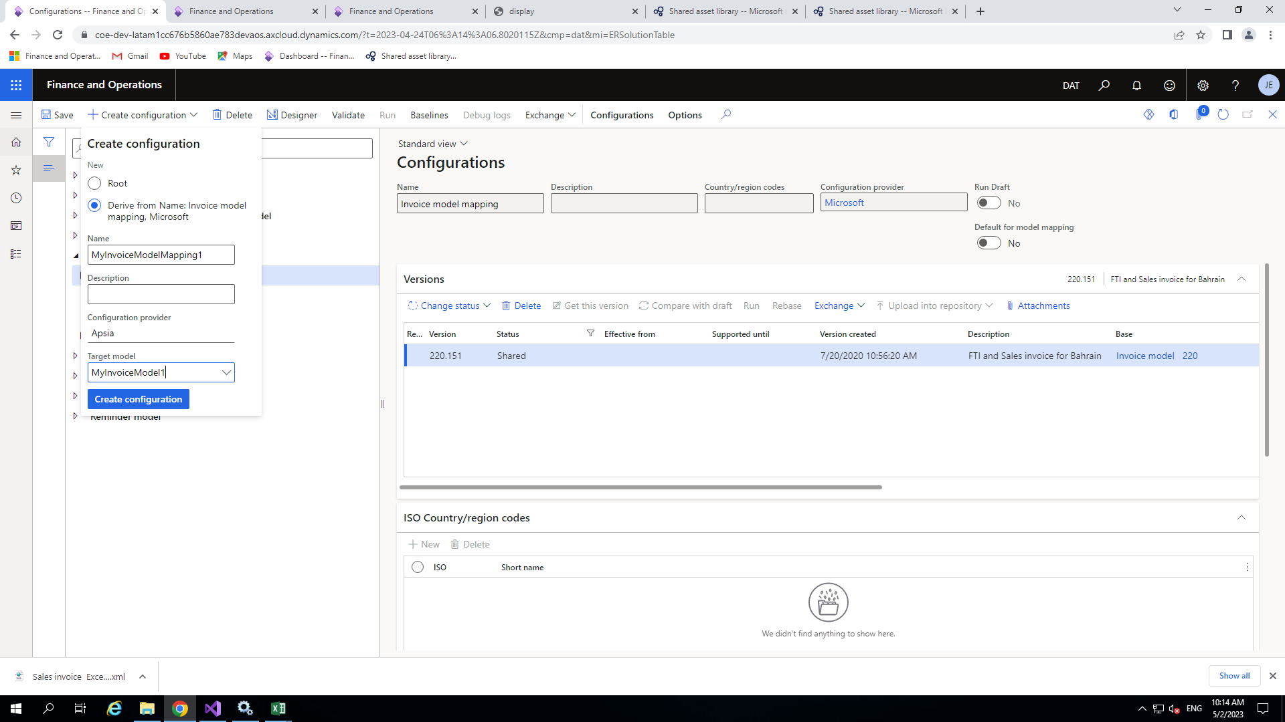

Slide 40
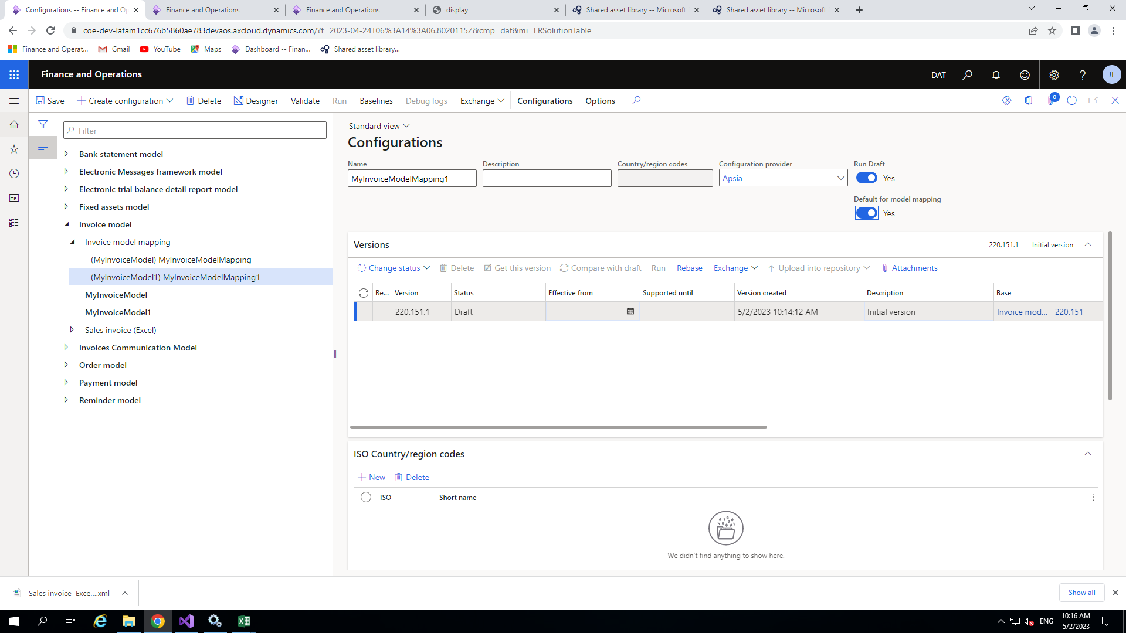
Now your model mapping will be visible in the window.

Slide 41
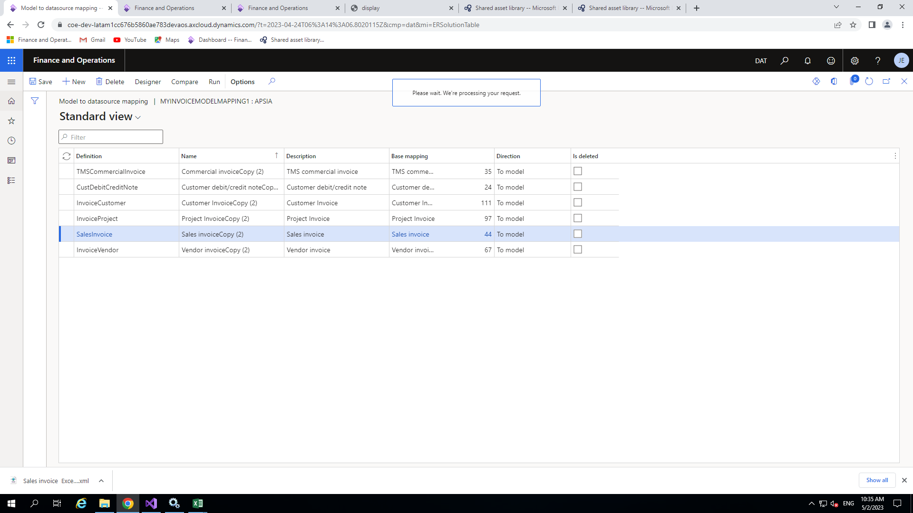
Binding data field to data model
Now choose your newly created model mapping and click on the designer new window will open including one or more data source for mapping here you need choose one like I will choose sales Invoice and later will click on the designer again for the mapping.

Slide 42
Now you will have to find the data source of your field which you want to add in the report here my field in belong to CustomerInvoiceJournal so for this I click on $SalesInvoiceTmp>Relations>Customer Invoice Journal(CustInvoiceJour)>Relation>CustGroup>Description(Name)
Then go to Data Model area and find your field which you have been created previously.
Choose your field and click on Bind which is on the top on Data model area
After that click on save.
You can see this process in the picture in the next slide.

Slide 43
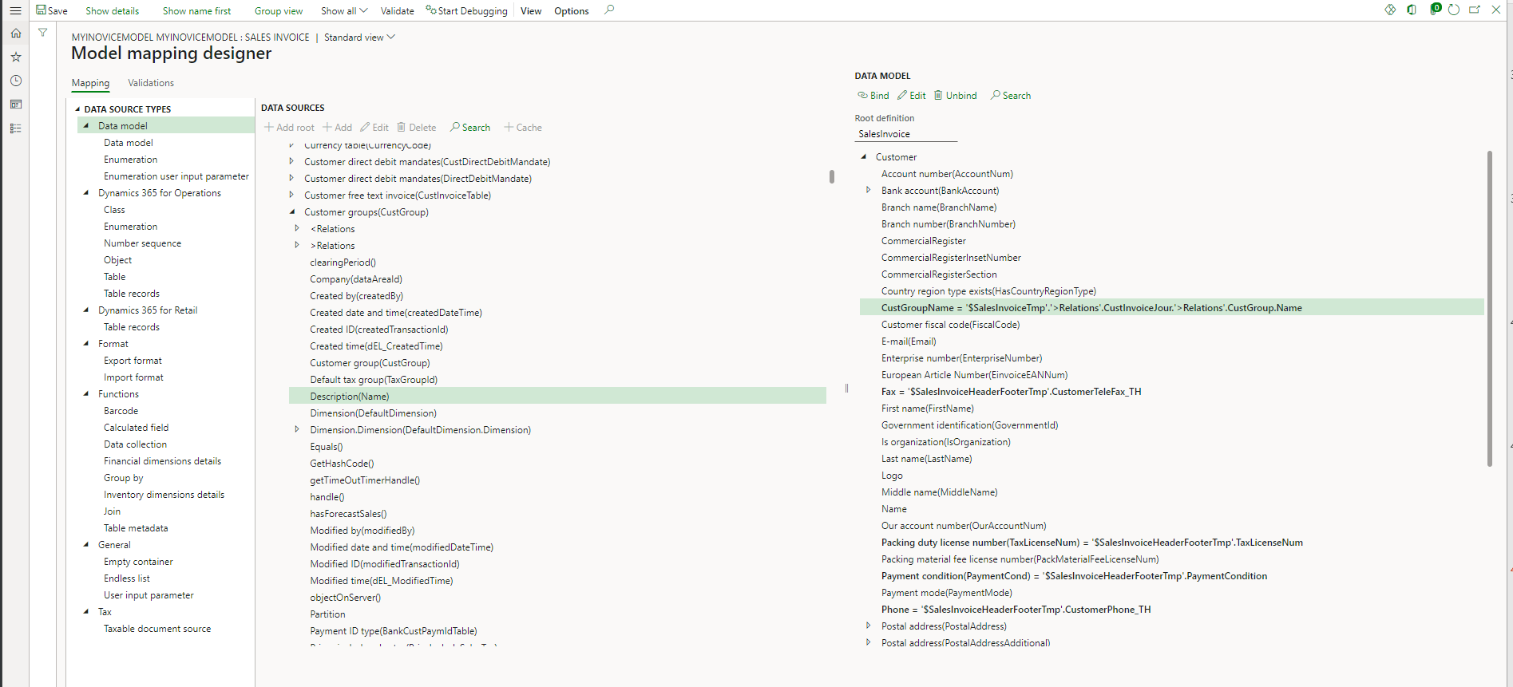

Slide 44
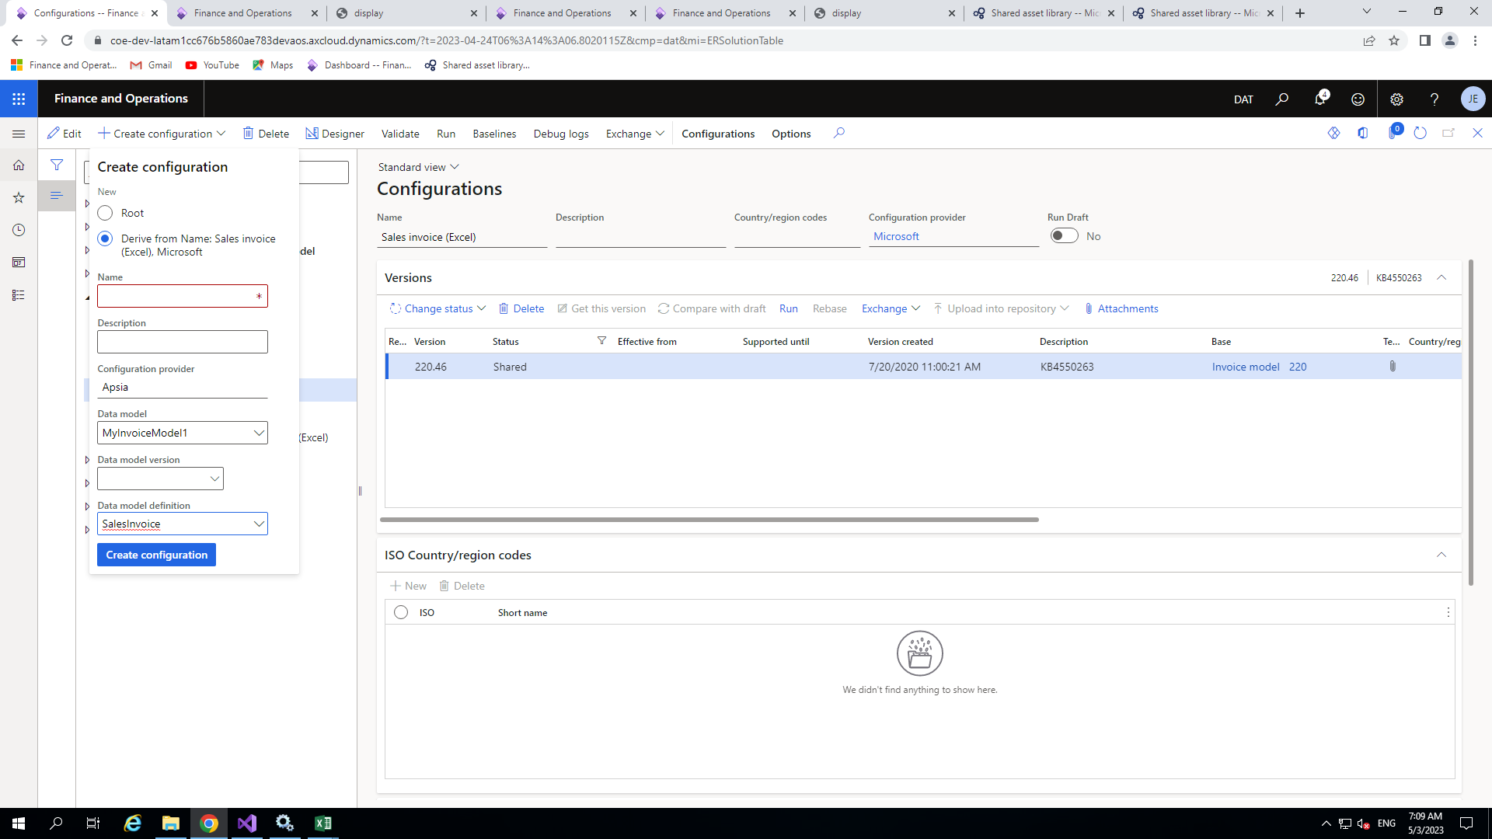
FormATTING CONFIGURATION
Choose your format and click on Create Configuration in to do the changes under your configuration providers .
Give proper name(MySalesInvoice) then choose your configuration provider (Apsia)and data model(MyInvoiceModelMapping).After that click on create configuration.

Slide 45
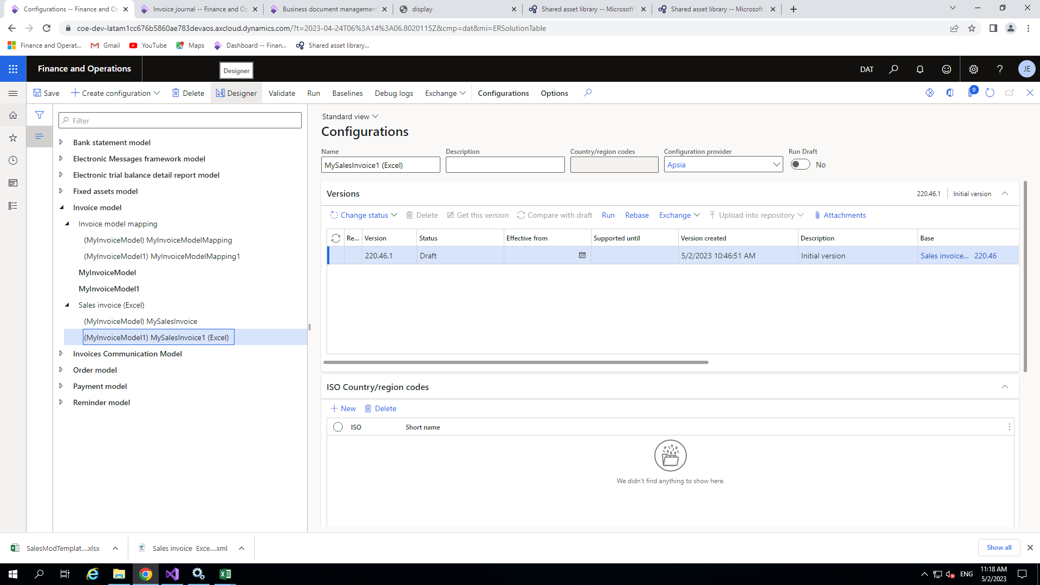
Now your format (MySalesInvoice) will be add.

Slide 46
Customization template
Before moving ahead we need to download the report format in excel for the customer Invoice journal which is already available in the SalesInvoice(Excel)
Now Go to and choose standard SalesInvoice(Excel) or your My sales Invoice then click attachment .

Slide 47
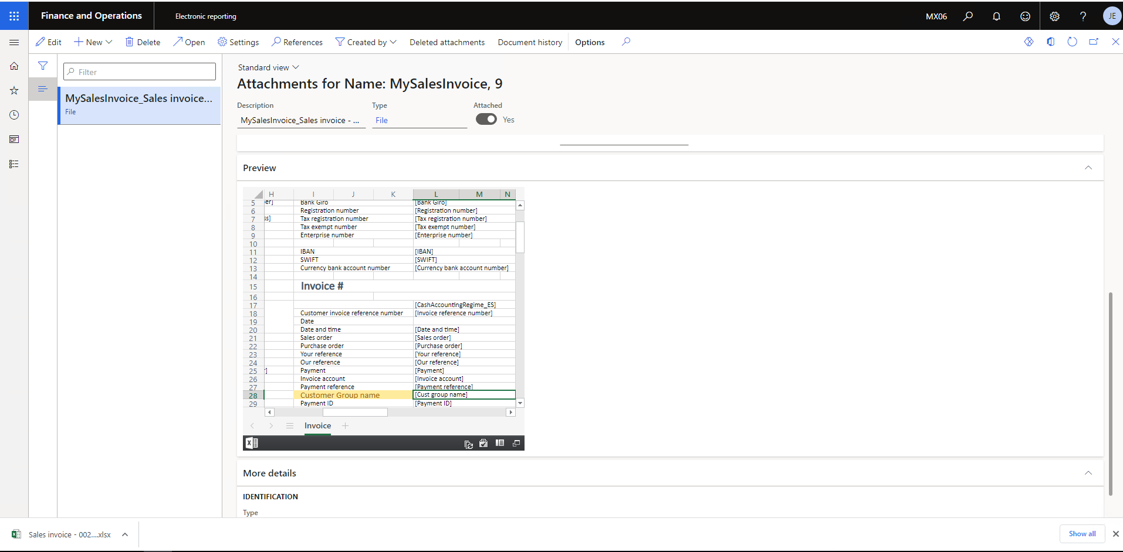
New window will open now go to Preview Tab and you can see here the report format which will come when we will print customer Invoice Journal form data
Now choose this and click on open button
It will download in your system
Once It downloaded you need to add your field like customer Group Name into your template and save it

Slide 48
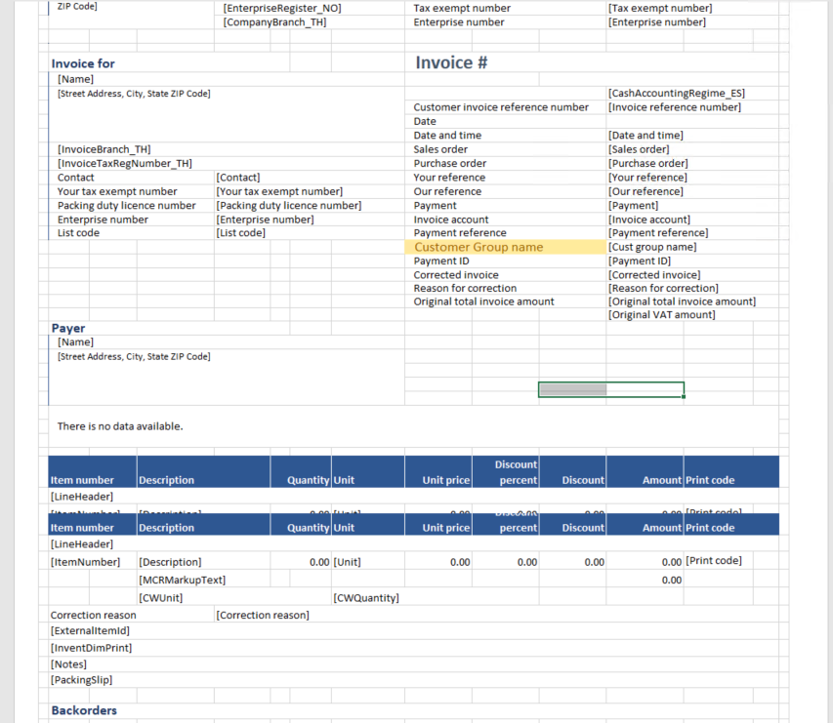
You can add your required field in the template shown in the picture and you can add field like Cust Group Name.
Then save it for importing purpose.

Slide 49
Importing the template
Now choose your newly created format (MySalesInvoice) and click on designer
In Action pane tab you will see import button.

Slide 50
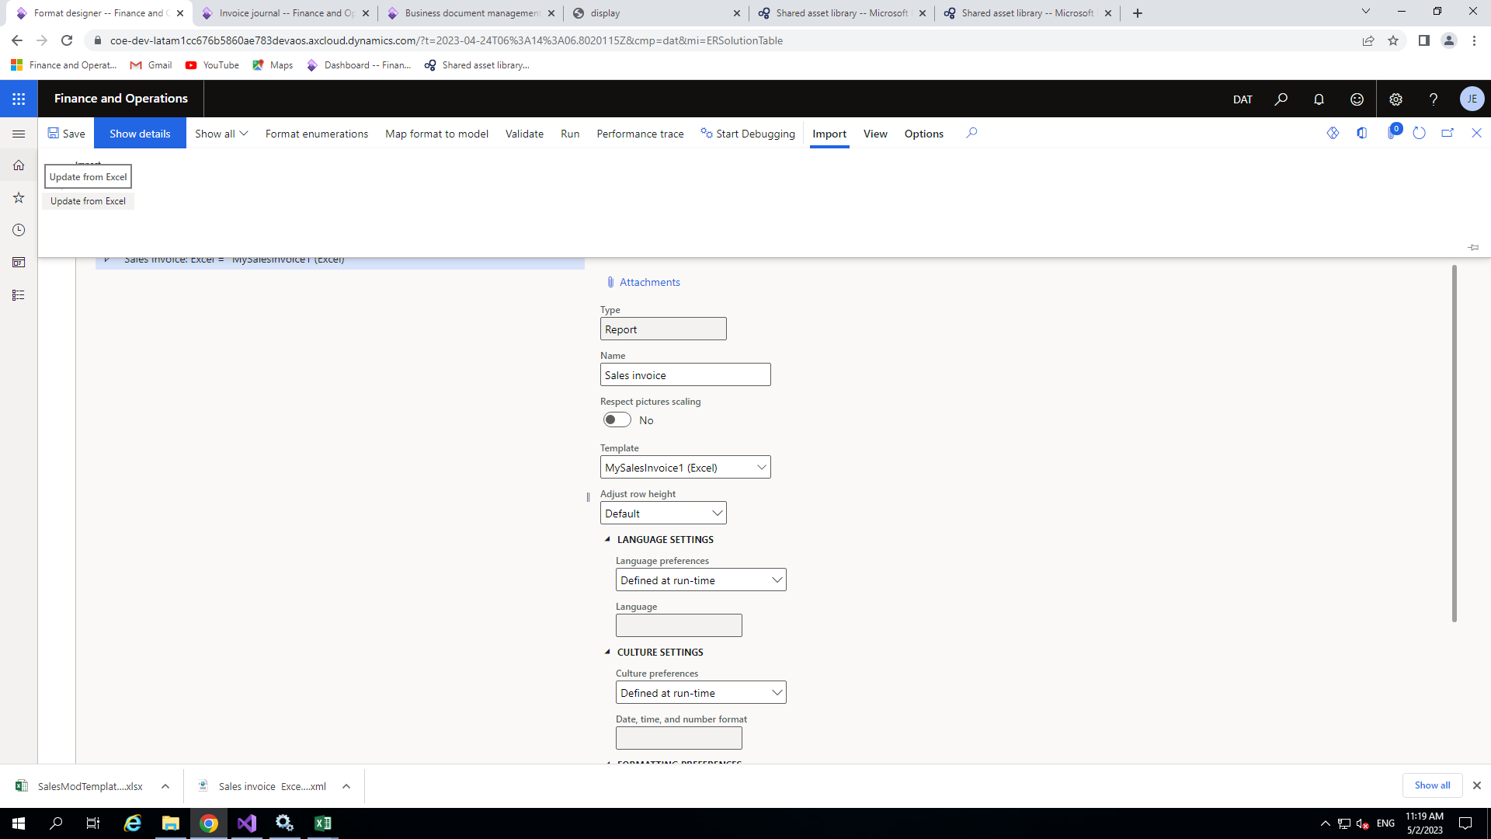
The next step is to import new template so just simply click on import and update from Excel

Slide 51
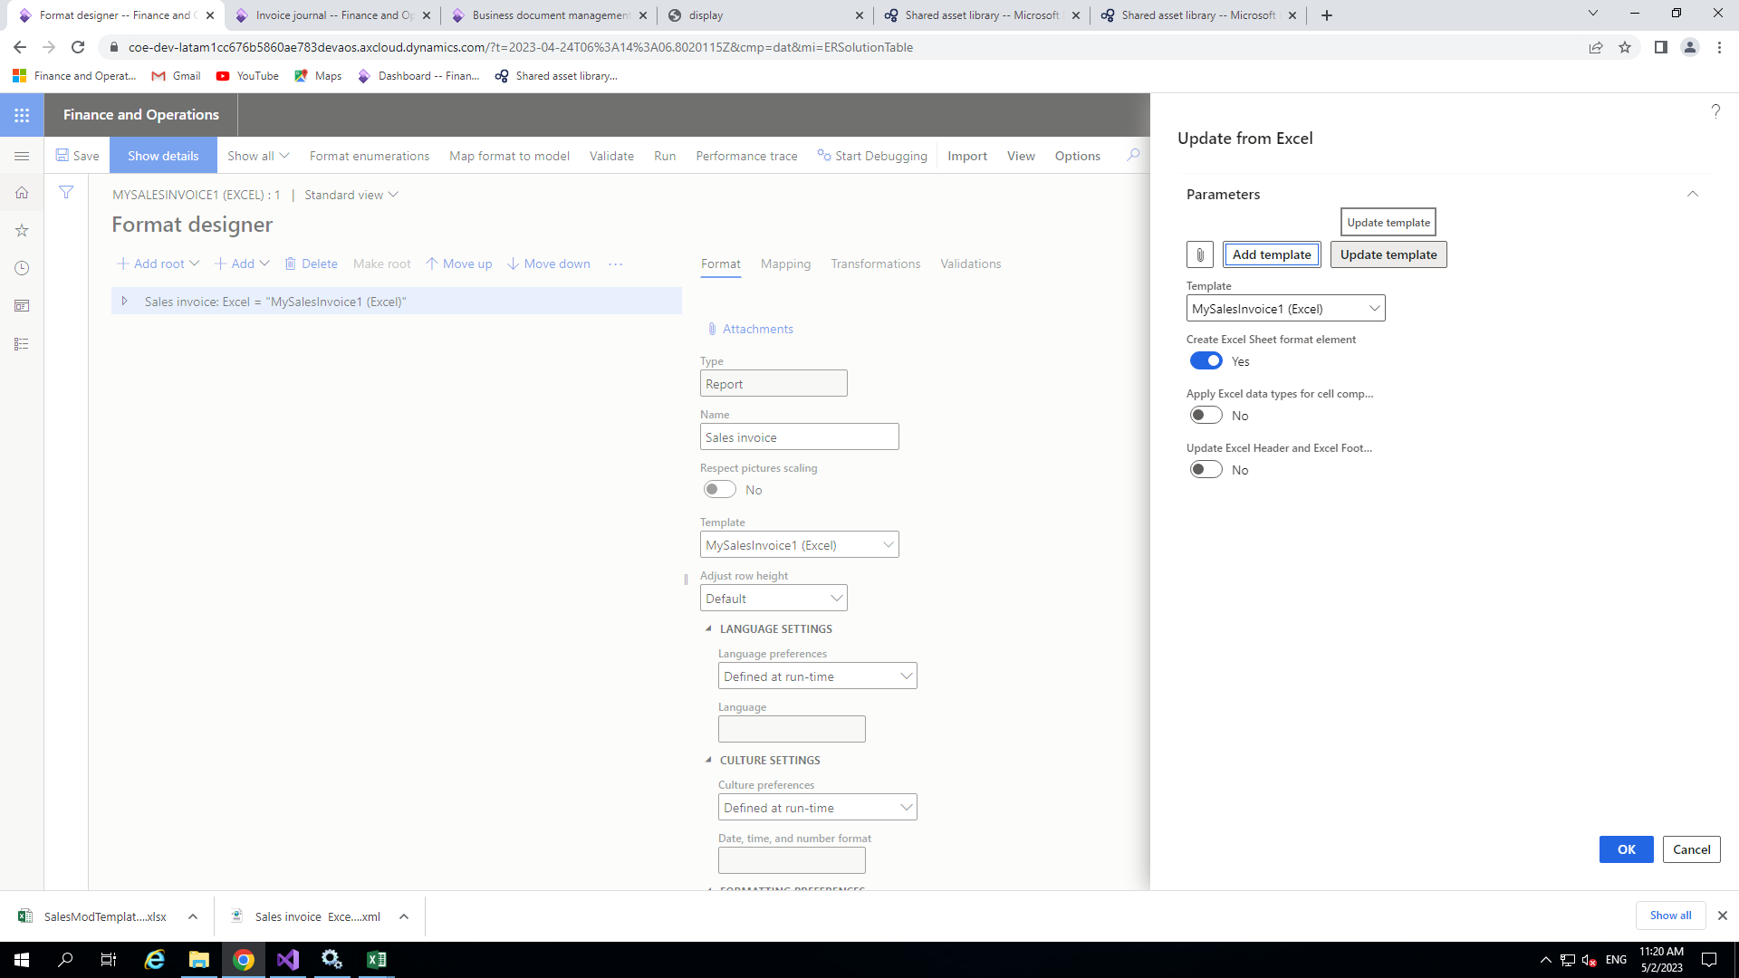
In ‘Update from Excel’ click on Update template and choose your customized template.
<create Excel sheet format element> keep it turn on and then click ok.

Slide 52
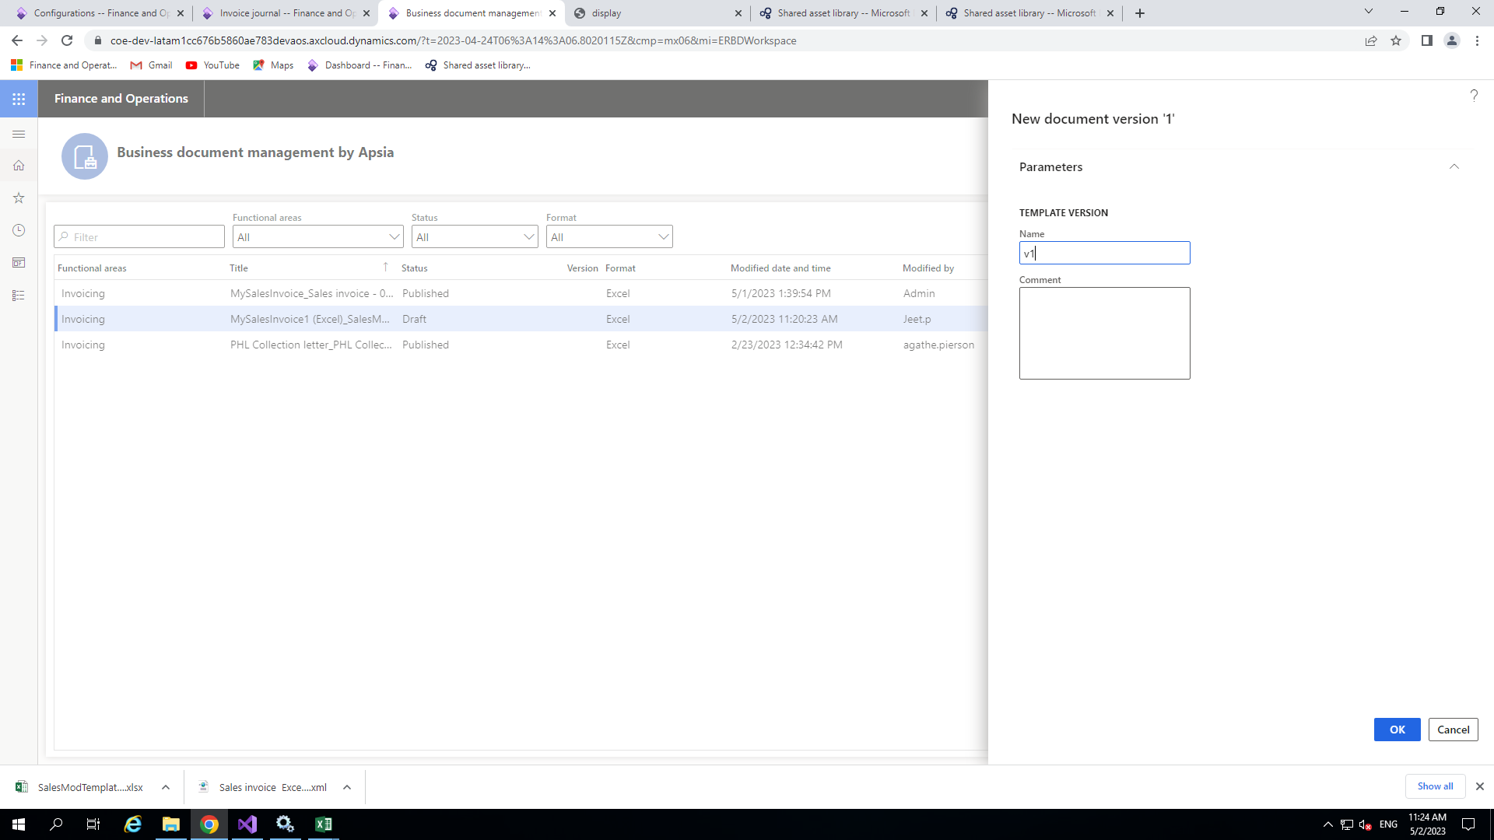
Business Document Management
Now open business document management from front end and select the invoice which you imported and just click on edit button at right side below preview of the excel
After that one dialog box is open just enter the version number and click Ok .

Slide 53
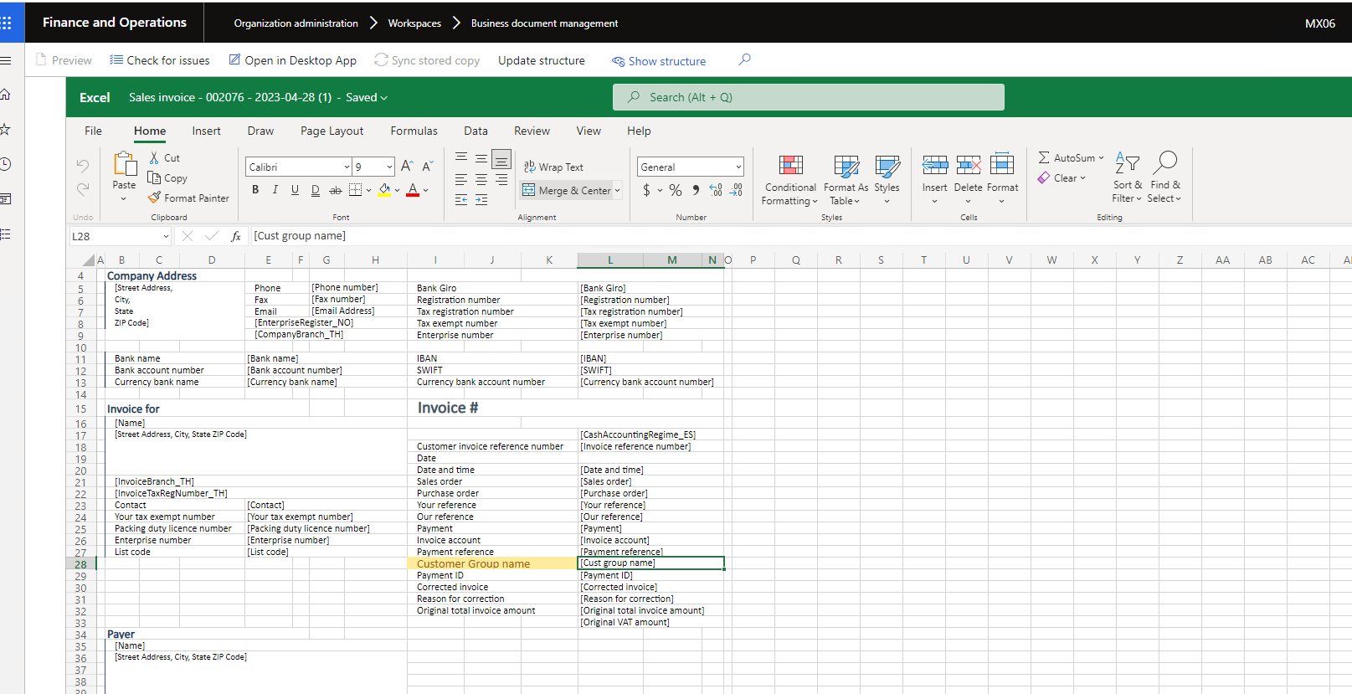
Once the excel file is open click on show structure .

Slide 54
Then Template structure dialog box will open .Here You can see the structure of your excel in xml format .Now identify the range where you want to add the field.
In my case I will add the field under Range<DocumentsDetails>Vertical.
I selected this range and my excel template field which I want to mapped already selected .
Now click on Add >cell then give proper name like I gave the name as ‘DocumentDetails_CustGroupName_Value’
And then click on ok button.

Slide 55
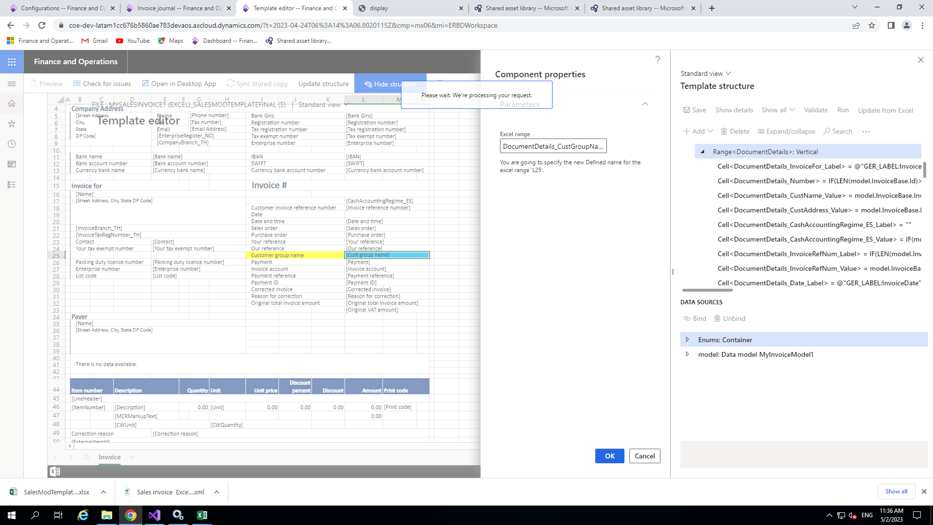

Slide 56
Binding field with the data source
Now I need to bind the field with the data source for this click on show binding option available in this window if you are not able to see this click on there dot it will seen and click on this .
A new window pane of data source will appear this window. Now choose your model and try to find out the field which you already added in the data model.
In my case model>customer>CustGroupName
After selecting my field I clilcked on the Bind button
Now it has been bind Now save it .

Slide 57
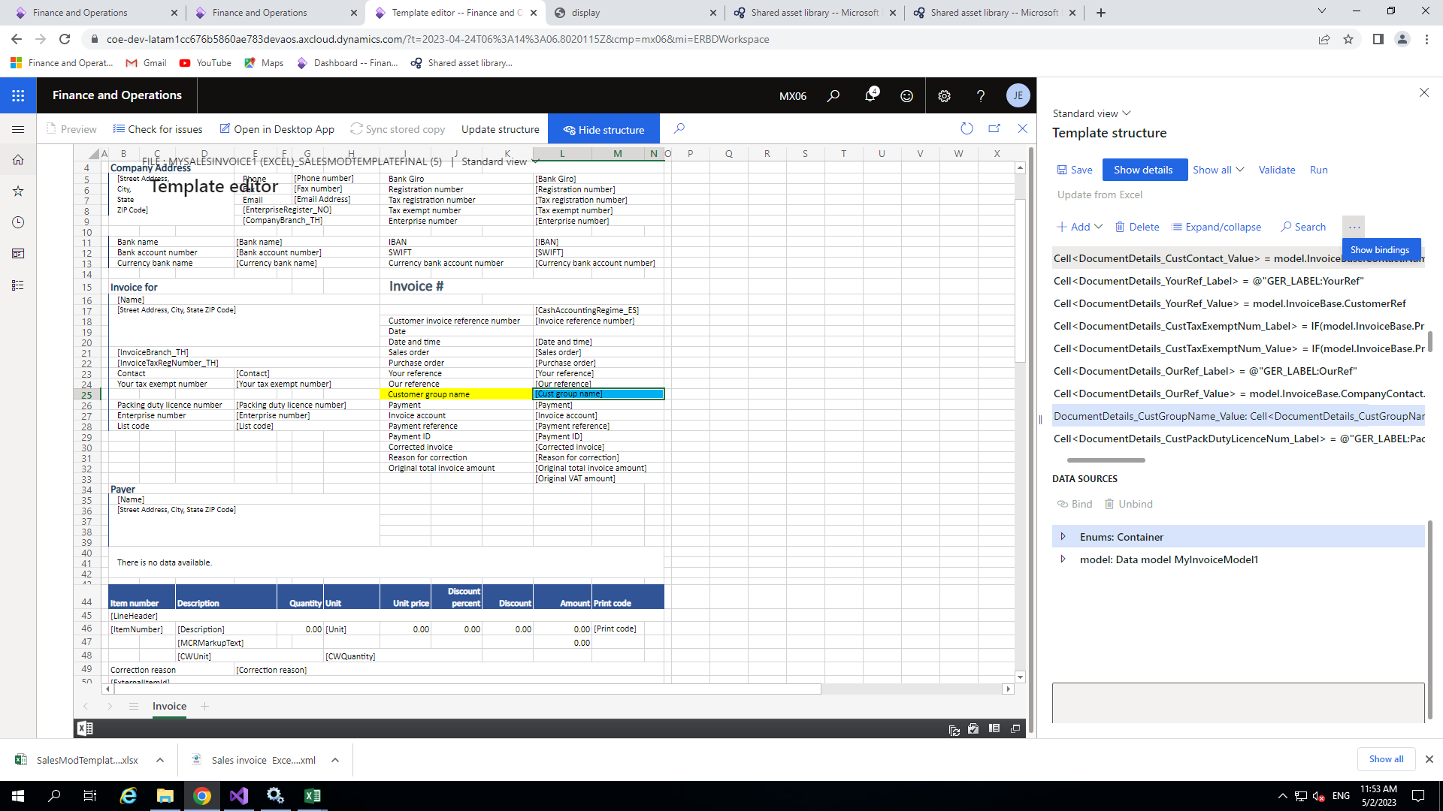

Slide 58
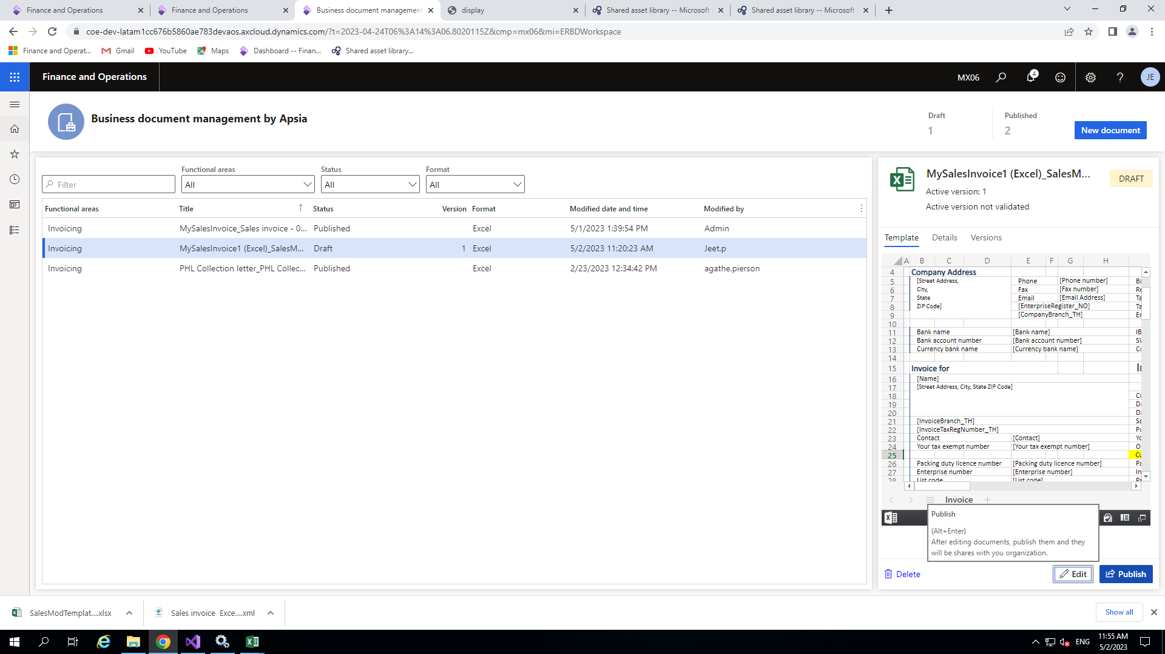
After binding the field you need to publish you newly added Excel template .
So close binding window and Excel template window and Now click on publish button which is near to Edit button.
Now your template has been published for the reporting.

Slide 59
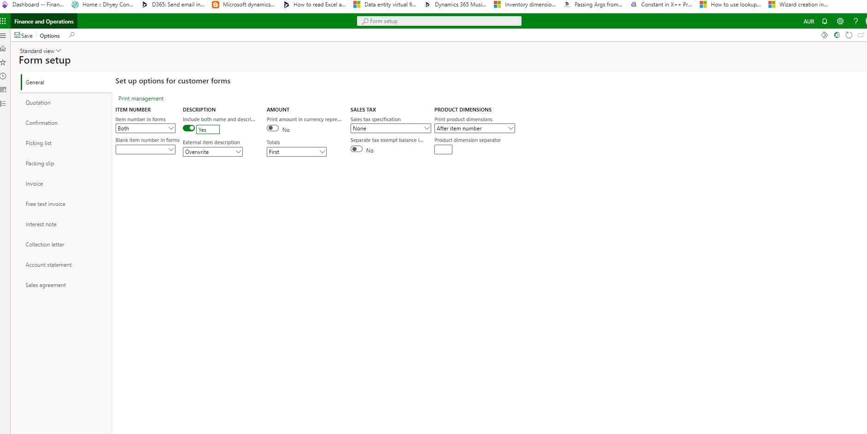
Form Setup
Next step you need set some parameter in form setup form
Go to Account receivable>setup>forms or you can directly search.
Set the parameter of the form as in the following picture.

Slide 60
Print management
Now click on Print management option which is on the same screen .
Here we need to set our newly published Report Format.
For this Go to >Customer Invoice
Click on Original<Default> if it already available it’s ok other wise we can add clicking on the new
Now under the setting go to Report format and here choose your format like I am choosing here MySalesInvoice
You can also change the destination like I set it as Screen.

Slide 61
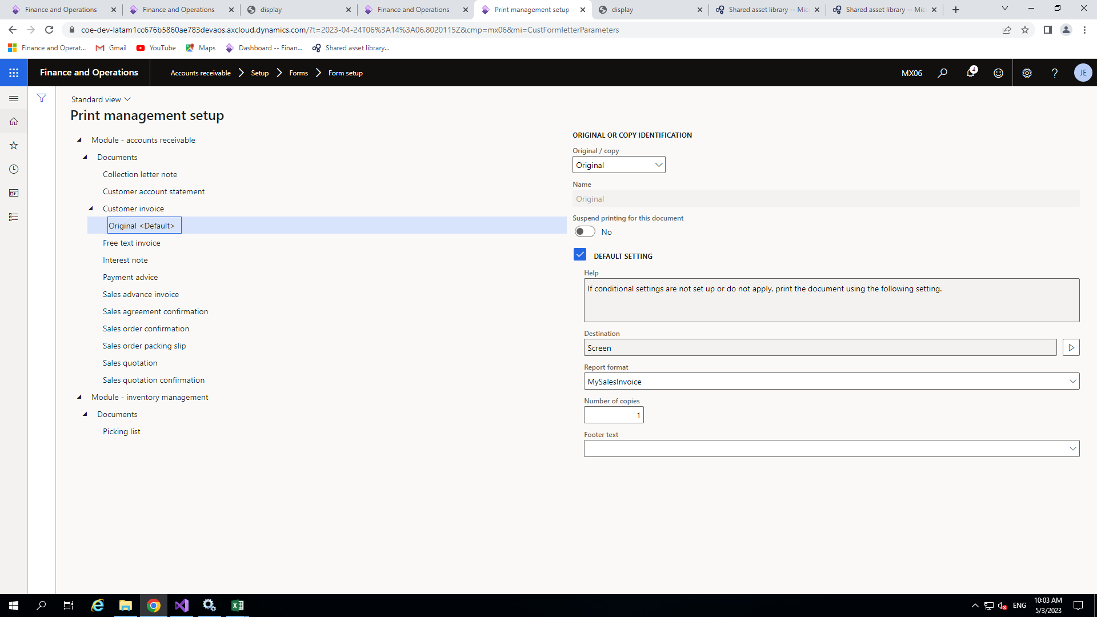

Slide 62
Printing final output
Now we are all set to see our output
Now go to custInvoiceJournal form and select any record and click on View>use print management.
Here it will ask for debugging if you set you model user parameter for debugging other click no .
Your report will download in excel format.

Slide 63
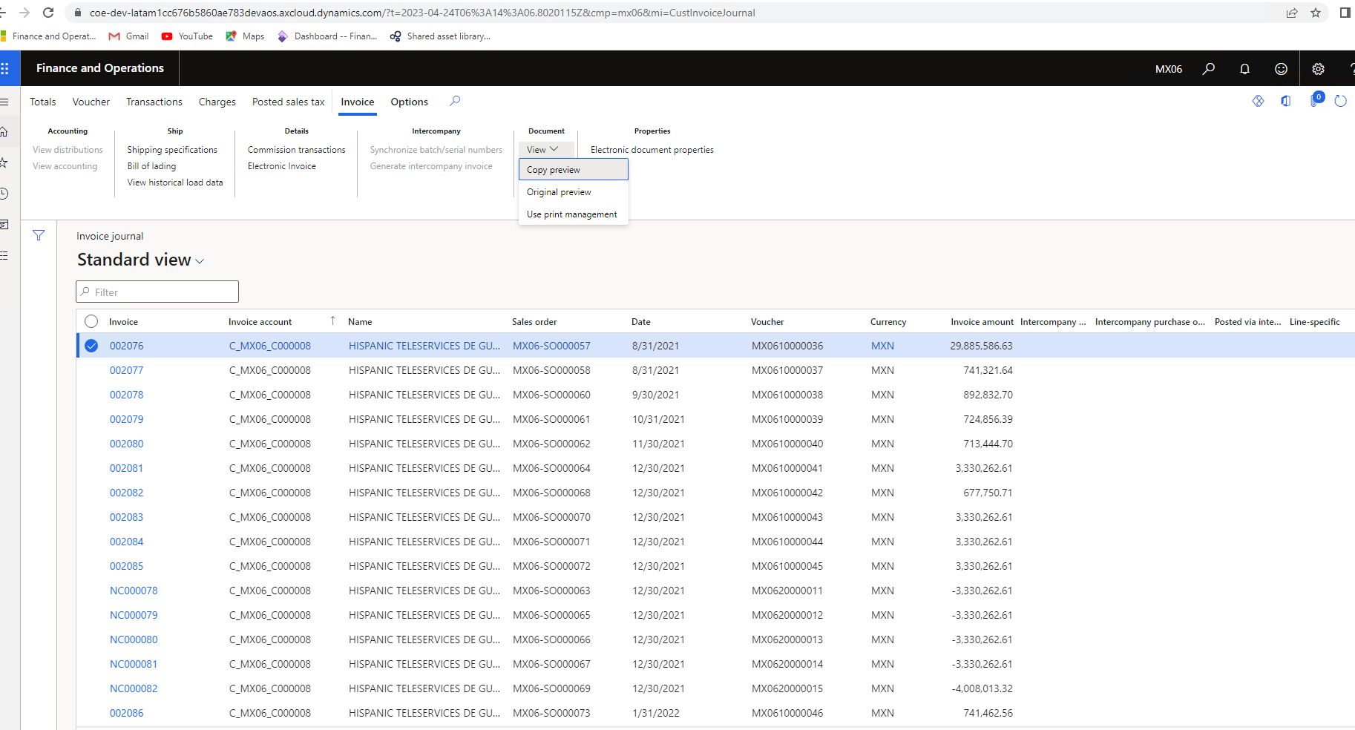

Slide 64
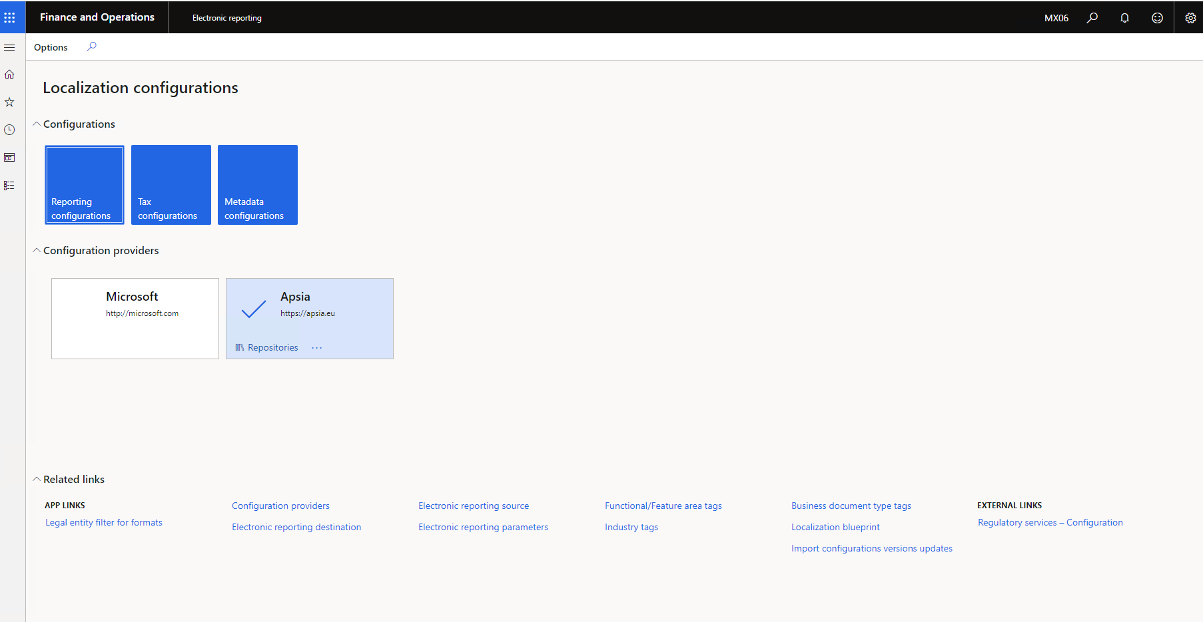
Electronic reporting destination
Go to workspace>Electronic Reporting
After that click on Electronic reporting destination

Slide 65
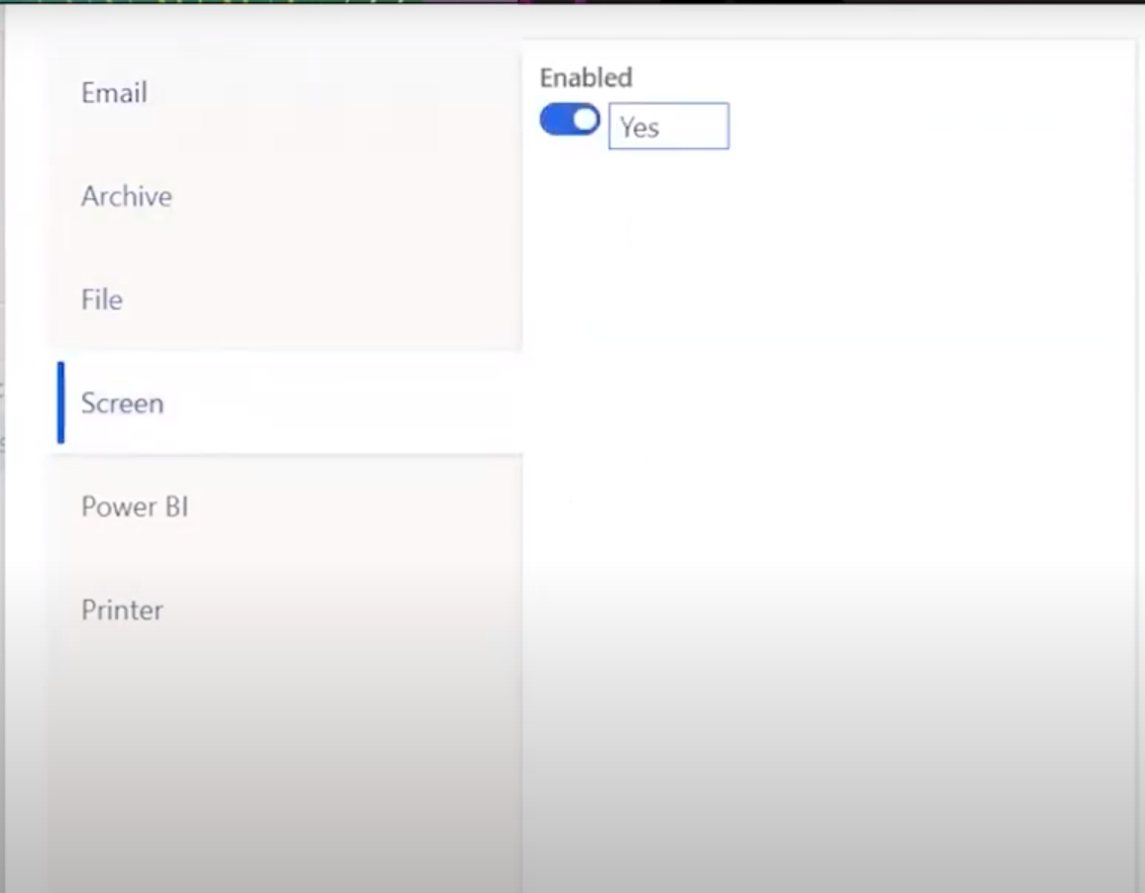
Chosse your format and need to set the file destination so click on New button then Name lilke I set Screen(pdf) as name .
Choose file component name I choose Sales Invoice.
After that click on setting pop up window will open and set it according shown in picture.
Then check the convert to pdf so output will come in pdf format.
Now save all setting we are all set now to print our report in pdf format.

Slide 66


Slide 67

Final Output In pdf format
Now go to Customer Invoice Journal form click on view>Use print Management or you can click on Original preview.
Now you report will print as following.
Here you can see the Customer Group name.

Slide 68
Thank you

